Slide 1



Slide 2
America: Two Enduring Stories

Slide 3
1. Land of Opportunity:
Work hard, and you can become anything you want to be.

Slide 4
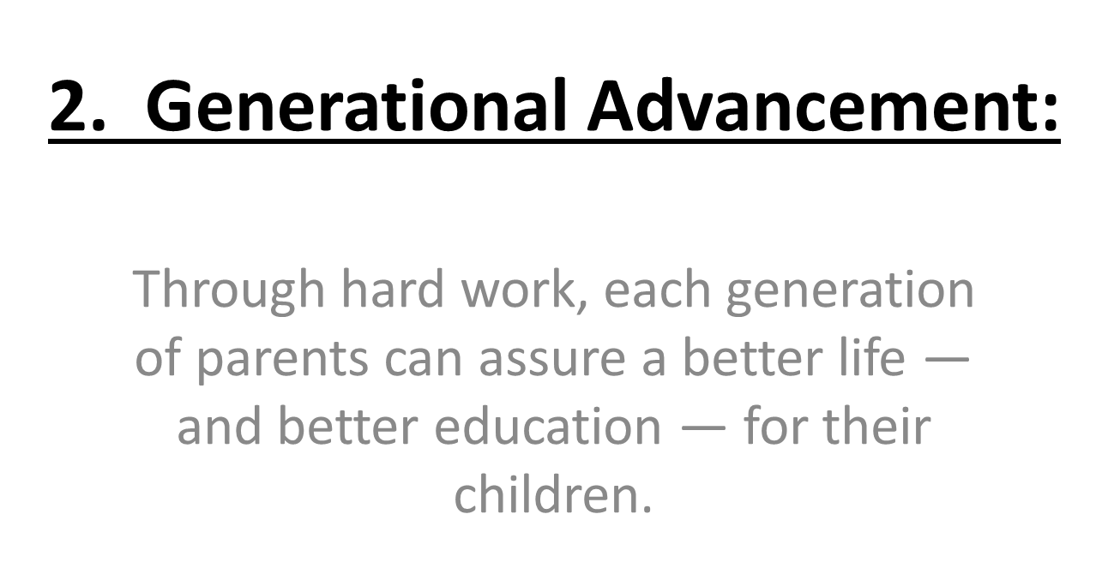

Slide 5
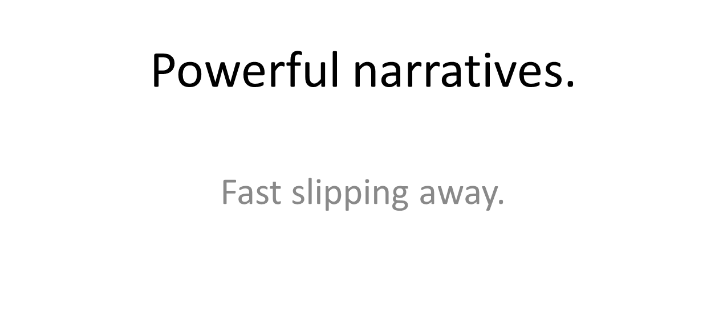

Slide 6
These stories animated hopes and dreams of people here at home
And drew countless immigrants to our shores

Slide 7
Yes, America was often intolerant…
And they knew the “Dream” was a work in progress.

Slide 8
We were:
The first to provide universal high school;
The first to build public universities;
The first to build community colleges;
The first to broaden access to college, through GI Bill, Pell Grants, …

Slide 9



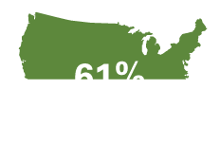
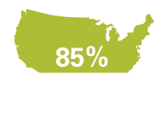
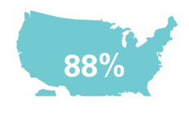
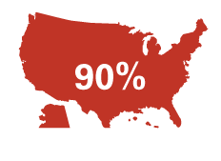
Percent of U.S. adults with a high school diploma
1920
1940
1960
1980
2000
2012

Slide 10

Percent of U.S. adults with a B.A. or more
1920
1940
1960
1980
2000
2012
11%
23%
29%
4%
6%
33%

Slide 11
Progress was painfully slow, especially for people of color. But year by year, decade by decade…

Slide 12
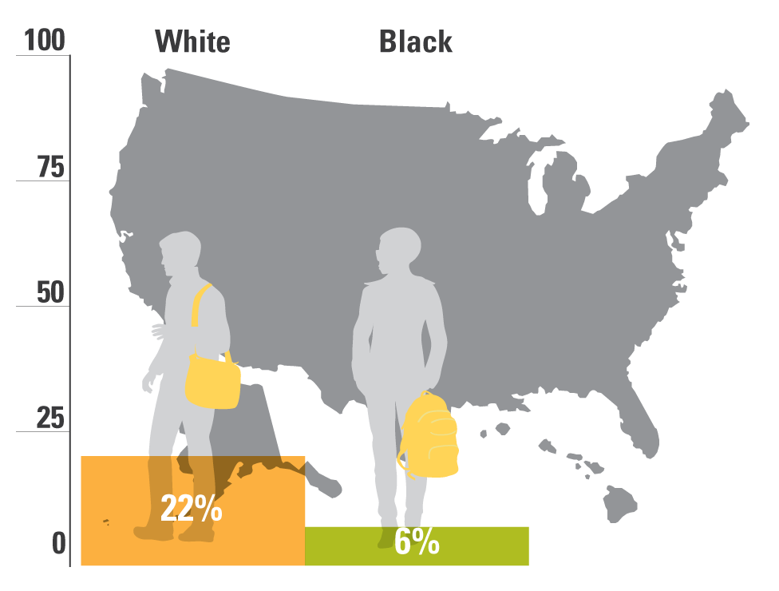
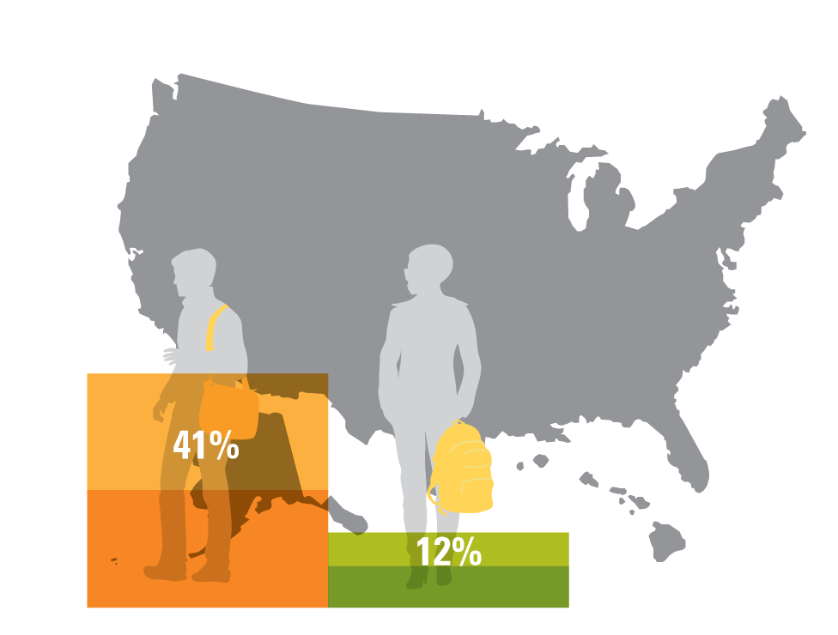
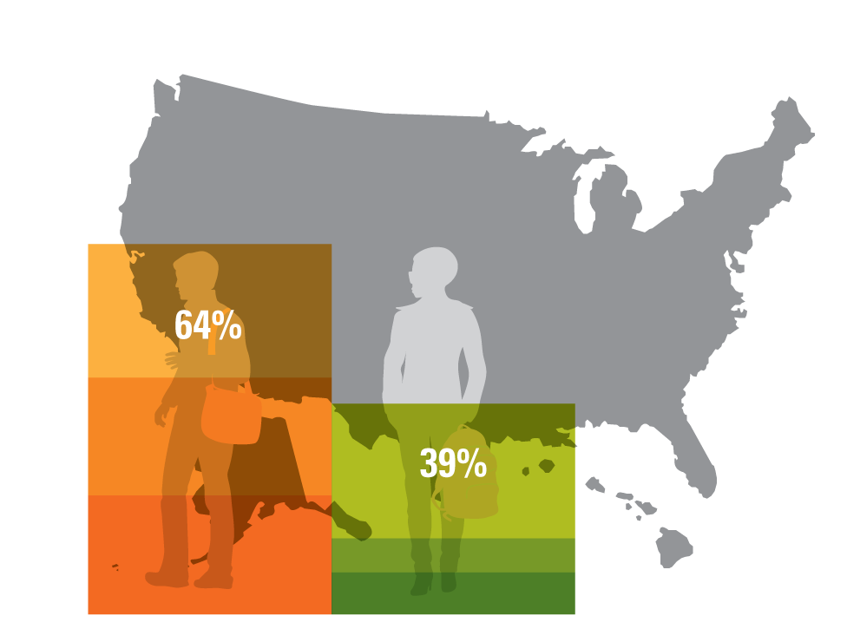
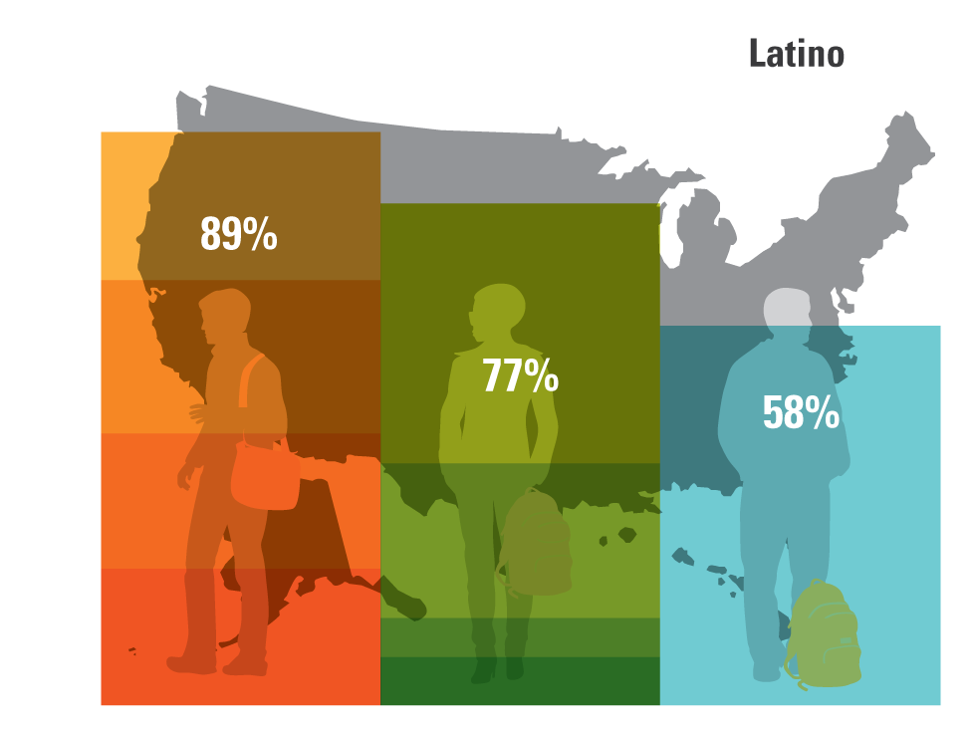
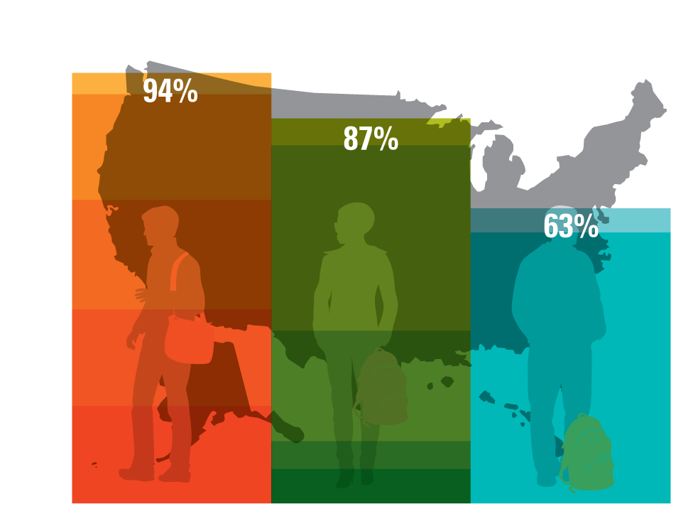
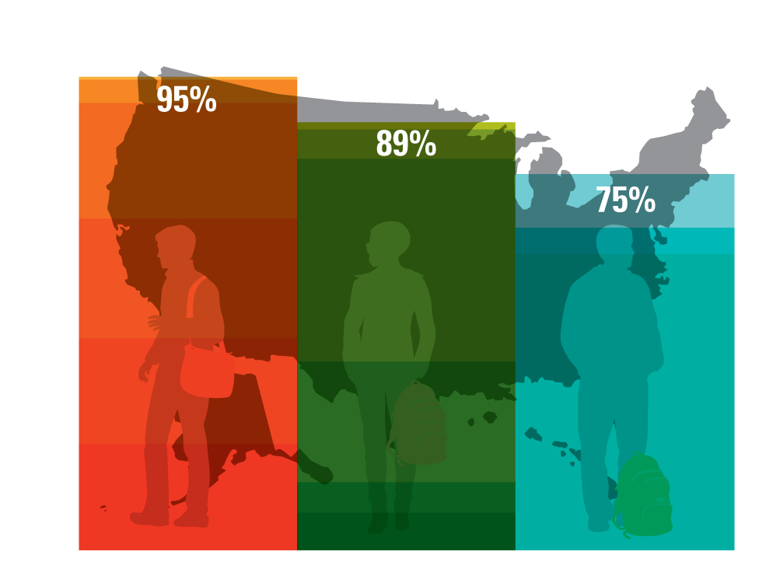
Percent of U.S. adults with a high school diploma, by race
1940
1920
1960
1980
2000
2012

Slide 13
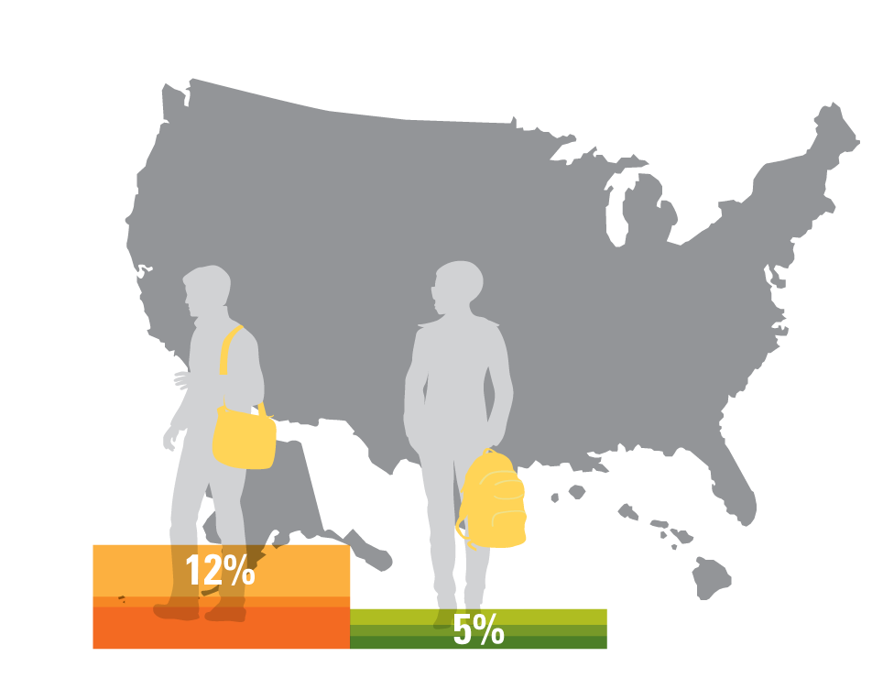
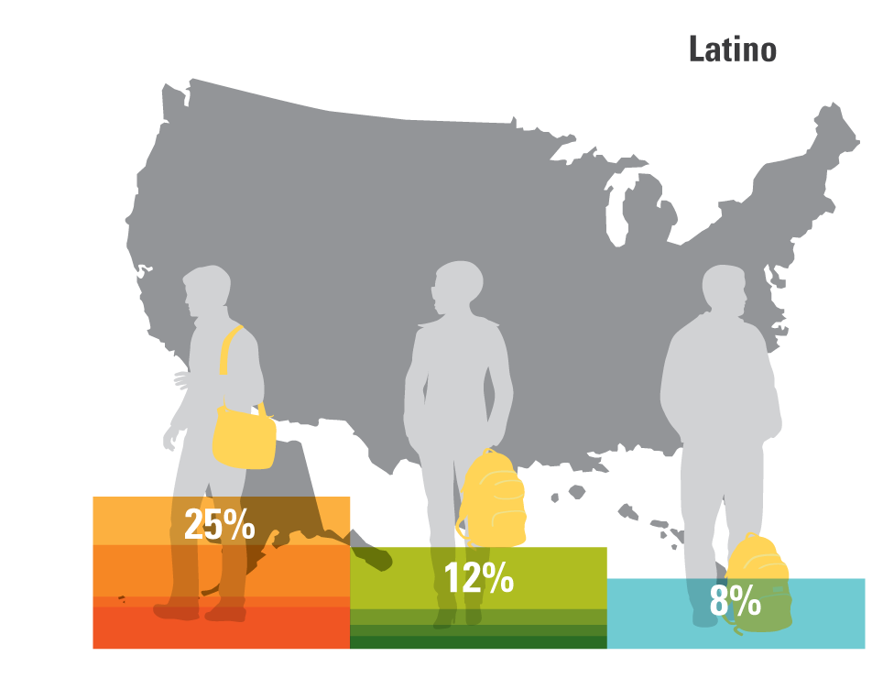
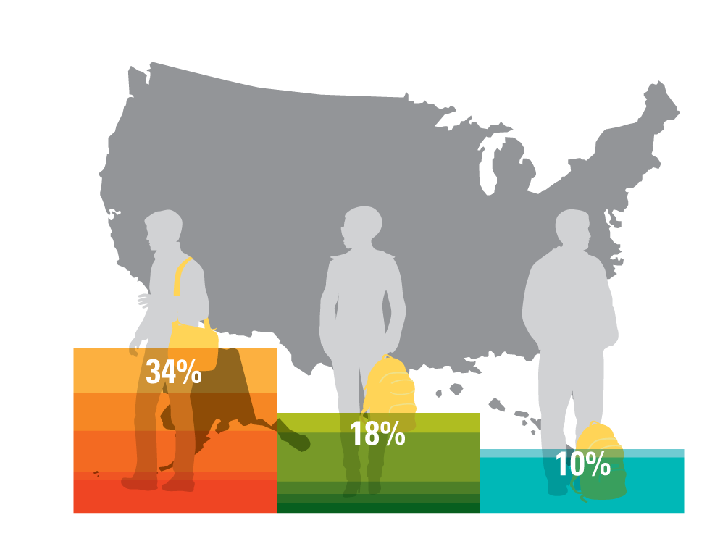
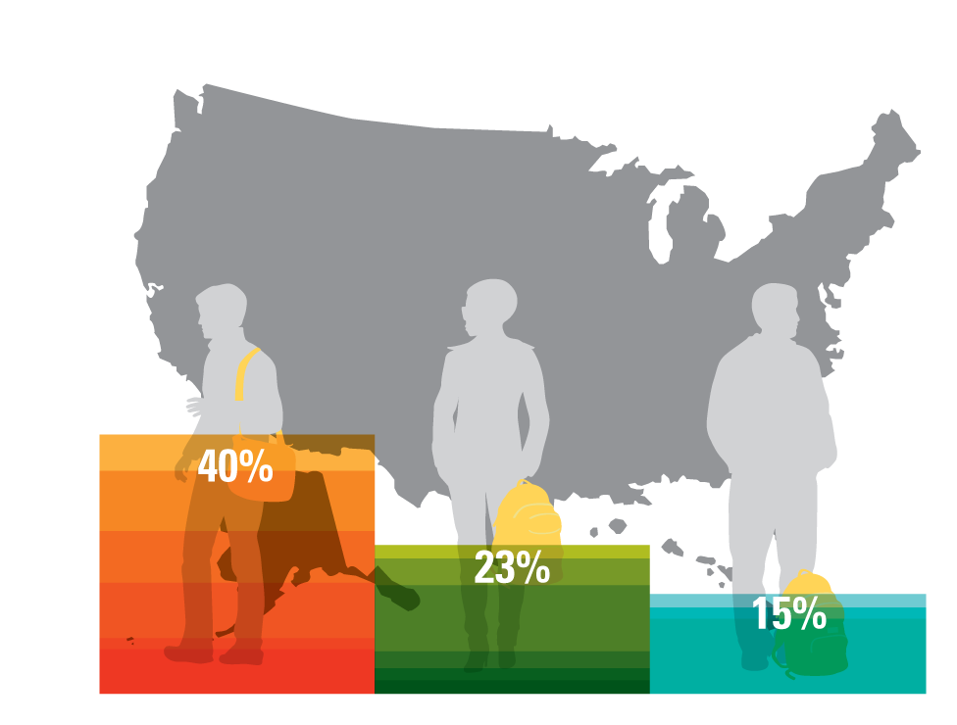
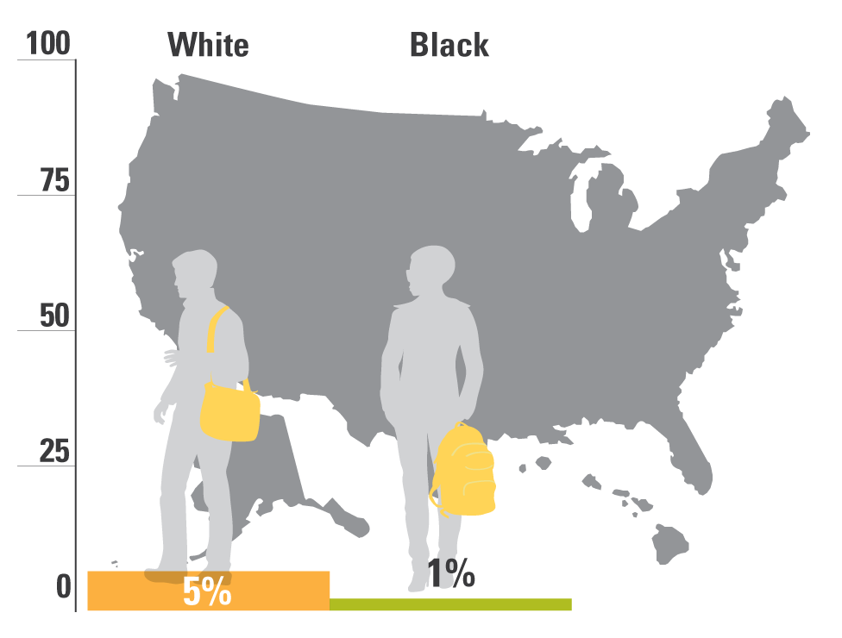

Percent of U.S. adults with a B.A. or more, by race
1960
1980
2000
2012
1920
1940

Slide 14
Then, beginning in the eighties, growing economic inequality started eating away at our progress.

Slide 15
In recent years, most income gains have gone to those at the top of the ladder, while those at the bottom have fallen backwards.
Source: Stiglitz, “Inequality is a Choice,” New York Times, October 13, 2013.

Slide 16
Instead of being the most equal, the U.S. has the third highest income inequality among OECD nations.
United States
Note: Gini coefficient ranges from 0 to 1, where 0 indicates total income equality and 1 indicates total income inequality.
Source: United Nations, U.N. data, http://data.un.org/DocumentData.aspx?q=gini&id=271: 2011

Slide 17
Not just wages and wealth, but social mobility as well.

Slide 18
U.S. intergenerational mobility was improving until 1980, but barriers have gotten higher since.
Source: Daniel Aaronson and Bhashkar Mazumder. Intergenerational Economic Mobility in the U.S.,1940 to 2000. Federal Reserve Bank of Chicago WP 2005-12: Dec. 2005.
Notes:
From the Aaronson and Mazumder report: “In particular, mobility increased from 1940 to 1980, but fell sharply during the 1980s and failed to revert, perhaps even continued to decline, in the 1990s.”
From the Aaronson and Mazumder report, the figure for 2000 (0.58) is not statistically significant. The figure for 1990 (0.46) almost mirrors the number cited for the US in the cross-country analysis on the next slide.

Slide 19
The US now has one of lowest rates of intergenerational mobility
Source: Corak, Miles. Chasing the Same Dream, Climbing Different Ladders. Economic Mobility Project; Pew Charitable Trusts, 2010.
Notes:
Checked 1/8/14 JY
Updated 11/14/13 MW

Slide 20
At macro level, better and more equal education is not the only answer.
But at the individual level, it really is.

Slide 21
There is one road up, and that road runs through our schools and colleges.

Slide 22

So, how are we doing?

Slide 23
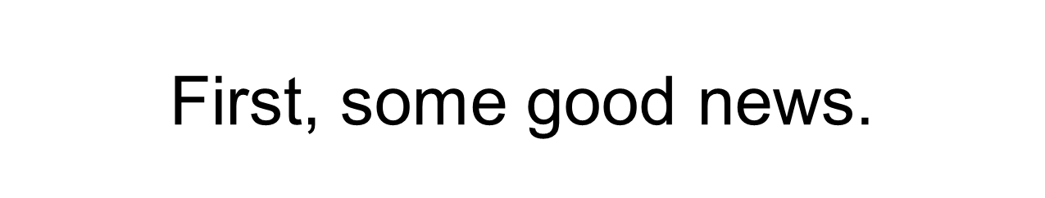
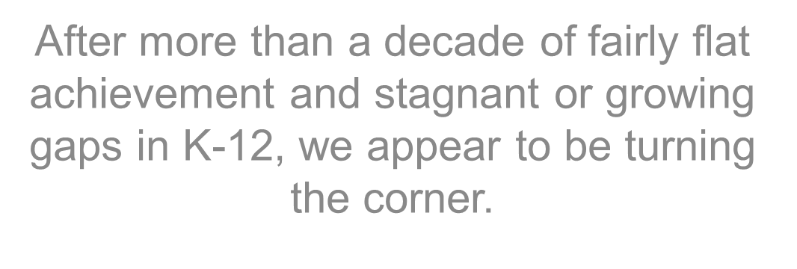

Slide 24
Since 1999, large gains for all groups of students, especially students of color
*Denotes previous assessment format
National Center for Education Statistics, “The Nation's Report Card: Trends in Academic Progress 2012”

Slide 25
Eighth-Grade Math:
Progress for all groups, some gap narrowing
*Denotes previous assessment format
NAEP 2008 Trends in Academic Progress, NCES

Slide 26
12th Grade Math:
Progress for all groups, but smaller
National Center for Education Statistics, NAEP Data Explorer, http://nces.ed.gov/nationsreportcard/nde/ (Proficient Scale Score = 176; Basic Scale Score = 141)

Slide 27
Also, high school graduation rates are up, reaching an all-time high last year.

Slide 28
In other words, reason to be encouraged—if cautiously so.
Different story in Michigan.

Slide 29
In All-Important Area of Early Literacy, Michigan One of Only Five States with Declining Achievement Since 2003
29
FL
MA
TN
US Public
MI
Note: Basic Scale Score = 208; Proficient Scale Score = 238
NAEP Data Explorer, NCES

Slide 30
In Math, Michigan’s 8th Graders Show Little Improvement Compared with Leading States
NAEP Data Explorer, NCES (Proficient Scale Score = 299; Basic Scale Score = 262)

Slide 31
Across racial, ethnic and socio-economic groups, Michigan is in a free fall, with broad evidence of systemic failure .

Slide 32
Reasonably Well Known: Michigan’s African American Students at the Bottom Compared to Peers in Other States
NAEP Data Explorer, NCES (Proficient Scale Score = 238; Basic Scale Score = 208)

Slide 33
Less Well Known: Michigan’s White Students Perform Below Peers in All But West Virginia
NAEP Data Explorer, NCES (Proficient Scale Score = 238; Basic Scale Score = 208)

Slide 34
Michigan NAEP Performance
Relative Rank of All Students 2003-2015
 | 2003 | 2005 | 2007 | 2009 | 2011 | 2013 | 2015
4th Grade Reading | 28th | 30th | 30th | 34th | 35th | 38th | 41st
4th Grade Math | 27th | 32nd | 32nd | 38th | 41st | 42nd | 42nd
8th Grade Reading | 27th | 29th | 32nd | 32nd | 28th | 32nd | 31st
8th Grade Math | 34th | 33rd | 36th | 36th | 36th | 37th | 38th
Note: Rankings are among all 50 states
NCES, NAEP Data Explorer

Slide 35
Michigan NAEP Performance
Relative Rank of African-American Students 2003-2015
 | 2003 | 2005 | 2007 | 2009 | 2011 | 2013 | 2015
4th Grade Reading | 38th | 39th | 36th | 44th | 45th | 42nd | 41st
4th Grade Math | 37th | 40th | 40th | 43rd | 44th | 44th | 42nd
8th Grade Reading | 29th | 33rd | 38th | 37th | 34th | 33rd | 39th
8th Grade Math | 35th | 32nd | 39th | 42nd | 42nd | 41st | 37th
Note: Rankings are among the states that reported data for African-American students.
NCES, NAEP Data Explorer

Slide 36
Michigan NAEP Performance
Relative Rank of Latino Students 2003-2015
 | 2003 | 2005 | 2007 | 2009 | 2011 | 2013 | 2015
4th Grade Reading | 22nd | 15th | 13th | 25th | 26th | 24th | 33rd
4th Grade Math | 16th | 25th | 20th | 31st | 32nd | 40th | 43rd
8th Grade Reading | 5th | 13th | 38th | 13th | 4th | 21st | 3rd
8th Grade Math | 4th | 12th | 35th | 19th | 13th | 43rd | 30th
Note: Rankings are among all 50 states
NCES, NAEP Data Explorer

Slide 37
Michigan NAEP Performance
Relative Rank of White Students 2003-2015
 | 2003 | 2005 | 2007 | 2009 | 2011 | 2013 | 2015
4th Grade Reading | 13th | 26th | 33rd | 38th | 35th | 45th | 49th
4th Grade Math | 13th | 20th | 37th | 41st | 45th | 46th | 47th
8th Grade Reading | 12th | 30th | 37th | 38th | 37th | 41st | 42nd
8th Grade Math | 25th | 31st | 38th | 40th | 44th | 42nd | 42nd
Note: Rankings are among all 50 states
NCES, NAEP Data Explorer

Slide 38
Michigan NAEP Performance
Relative Rank of Low Income Students 2003-2015
 | 2003 | 2005 | 2007 | 2009 | 2011 | 2013 | 2015
4th Grade Reading | 35th | 35th | 35th | 37th | 36th | 37th | 45th
4th Grade Math | 34th | 37th | 40th | 45th | 46th | 48th | 48th
8th Grade Reading | 31st | 33rd | 41st | 37th | 26th | 31st | 35th
8th Grade Math | 34th | 37th | 42nd | 47th | 43rd | 44th | 46th
Note: Rankings are among all 50 states
NCES, NAEP Data Explorer

Slide 39
Michigan NAEP Performance
Relative Rank of Higher Income Students 2003-2015
 | 2003 | 2005 | 2007 | 2009 | 2011 | 2013 | 2015
4th Grade Reading | 24th | 35th | 36th | 36th | 35th | 38th | 48th
4th Grade Math | 20th | 29th | 35th | 35th | 43rd | 32nd | 45th
8th Grade Reading | 21st | 37th | 36th | 31st | 30th | 31st | 33rd
8th Grade Math | 34th | 35th | 38th | 39th | 40th | 39th | 41st
Note: Rankings are among all 50 states
NCES, NAEP Data Explorer

Slide 40
Add these numbers together and compare with other states?
Michigan is generally both low performing and low improving—not a good place to be in a country that is at best only middle-of-the-pack.

Slide 41
And for those who think that the “answer” is fast growth of charters…

Slide 42
Even though Boston’s Traditional Public Schools Perform Much Higher Than those in Detroit, Their Charters Overwhelmingly Have Higher Learning Gains
42
Source: “Urban Charter School Study Report on 41 Regions,” Stanford University Center for Research on Education Outcomes, 2015. https://urbancharters.stanford.edu/download/Urban%20Charter%20School%20Study%20Report%20on%2041%20Regions.pdf

Slide 43
Source: Center for Research on Education Outcomes, “Charter School Performance in Michigan” (Stanford, CA: CREDO, 2013), http://credo.stanford.edu/research-reports.html.

Slide 44
The Majority of Charter Districts (67%) Perform Worse than DPS among African American Students in 8th Grade Math
44
Note: Data above represents all charter districts statewide reporting African American proficiency rates in grade 8 MEAP math for 2013. Only charter districts where African American students comprise 50% or more of the total enrollment are included.
Source: MDE MEAP 2013, CEPI Educational Entity Master (EEM), CEPI Public Head Count

Slide 45
What Can You Do?
Main lessons from fast-improving states.

Slide 46


Slide 47
1. Don’t accept the excuses.

Slide 48
What we hear many say:
They’re poor.
Their parents don’t care.
They come to school without breakfast.
They don’t have enough books.
They don’t have enough parents.

Slide 49
But if there’s truly nothing that we can do, why are low-income students and students of color performing so much higher—and growing so much faster– in some schools? Some districts? Even some whole states?

Slide 50
Average Scale Scores, by District
Low-Income African American Students
Note: Basic Scale Score = 208; Proficient Scale Score = 238
NAEP Data Explorer, NCES

Slide 51
Average Scale Scores, by District
Low-Income Latino Students
Note: Basic Scale Score = 208; Proficient Scale Score = 238
NAEP Data Explorer, NCES

Slide 52
Scale Scores by State – African American Students
NAEP Data Explorer, NCES (Proficient Scale Score = 249; Basic Scale Score = 214)

Slide 53
Scale Scores by State – Latino Students
NAEP Data Explorer, NCES (Proficient Scale Score = 249; Basic Scale Score = 214)

Slide 54
Funding and demographics do not explain everything.
Tennessee has a similar level of per pupil spending and percentage of low-income students, yet it has been outpacing Michigan’s student improvement for years.
Notes:
Tennessee has similar rates of poverty for children (24%) as Michigan (23%), yet they continue to outpace us, particularly in 4th grade reading. We also spend more per pupil than Tennessee (Michigan $10,948 per pupil vs. TN $8,208 per pupil)

Slide 55
Tennessee African American Students Outpace Michigan Over Last Decade
NAEP Data Explorer, NCES

Slide 56
What you can do:
You can help by pointing to the successes elsewhere—and by pressing for similar results here.

Slide 57
Yes, this may make you “annoying.” But in the end, you don’t do education leaders any favors by being too nice. The good ones will use your demands to leverage change.

Slide 58
2. Build a Solid Foundation:
Ensure Strong Reading Skills for All Michigan Third Graders

Slide 59
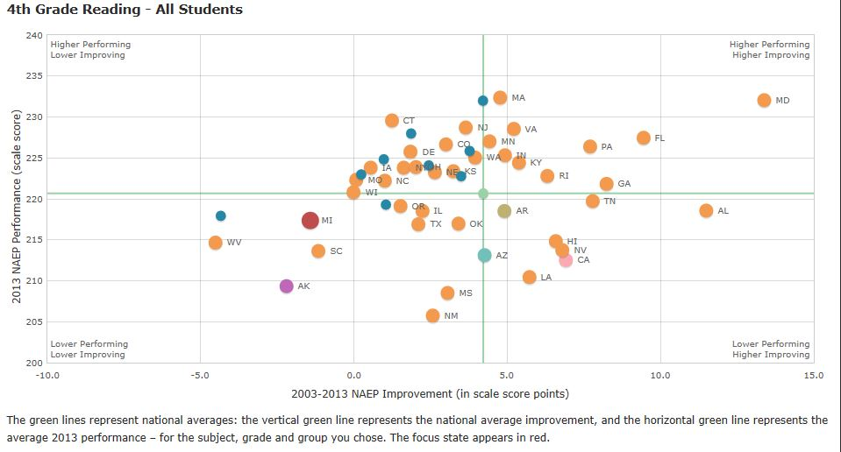
4th Grade Reading:
Michigan Low Performing, Low Growth while Florida is High Performing, High Growth

Slide 60
Florida: One of the Nation’s Top Gainers in Reading
Universal pre-k;
Investment in high quality professional development for elementary reading teachers, perhaps the best in the country;
Significant supports for struggling readers.

Slide 61
Recommendations for Michigan:
Michigan needs a multi-year, system-wide plan that includes:
  Investing in re-training our teachers so that they are up-to-date on the best instructional practices in reading;
  Careful evaluation of what is working and what is not, so our course can be corrected along the way;
  Ensuring students who are behind get the extra instruction they need to catch up; and,
  Prioritizing early reading in the state’s new accountability system developed under ESSA.

Slide 62
3. Support College- and Career-Ready Instruction Across the Grades

Slide 63
Michigan adopted high-quality standards, but didn’t invest in implementing them.
Largely left to districts, including those with little capacity.

Slide 64
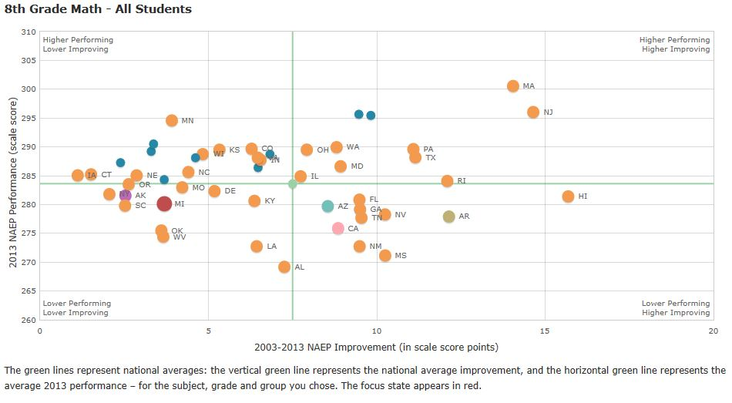
8th Grade Math:
Michigan Low Performing, Low Growth, while Massachusetts is High Performing, High Growth

Slide 65
What led to Massachusetts’ success?
Major reforms began in 1993 with education grand bargain:
  High standards and increased accountability, in return for
  Greater and more equitable funding for schools, with increased dollars sent to schools with more children from low-income families.

Slide 66
Massachusetts: Career- and College- Ready Expectations & Teacher Supports
College- and Career- Ready Expectations
National leader in holding all students to rigorous standards, which included a new comprehensive assessment system.
Developed statewide curriculum frameworks & standards in core academic subjects.
Support for All Teachers
College- and career-ready training for thousands of educators.
Expanded learning time.
Joined other states to create tool to help educators assess quality of their lessons.

Slide 67
Investment in Systems Improvement
Emphasis on effective teaching and leadership, including teacher performance standards; annual evaluations of teachers and administrators; raised certification requirements; accountability for teacher prep programs; investment in development and retention of top teachers.

Slide 68
Recommendations for Michigan:
Stick with your existing college- and career-ready standards;
Provide training and ongoing support (including standards-aligned instructional materials) to teachers and leaders: quality implementation is everything.
Stay on track with the new assessment: Michigan needs to continue administering a fully aligned, independently reviewed, high-quality assessment like the initial iteration of the M-STEP.

Slide 69
4. People Matter: Develop Strong Leaders and Excellent Teachers

Slide 70
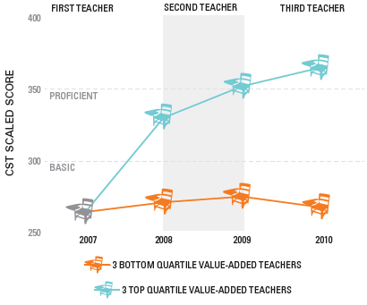
ACCESS TO MULTIPLE EFFECTIVE TEACHERS CAN DRAMATICALLY AFFECT STUDENT LEARNING
CST math proficiency trends for second-graders at ‘Below Basic’ or ‘Far Below Basic’ in 2007 who subsequently had three consecutive high or low value-added teachers

Slide 71
Effective Teaching and School Leadership
Tennessee has put a laser-like focus on effective teaching and school leadership.
  All teachers evaluated based on classroom observations and student learning data through the statewide evaluation system.
    Tennessee has trained 5,000 evaluators in the system.
  One of the nation’s first value-added data systems
  Multiple observations of classroom practice in final evaluations and individual evaluations private

Slide 72
Career- and College- Ready Expectations for All Students
Tennessee phased in the Common Core standards over multiple years, starting with math in grades 3-8 and a pilot of English standards in 60 school districts.
Invested $15 million in Common Core training. Identified more than 700 teachers with strong learning gains and trained them to be Common Core coaches for more than 30,000 educators.
Developed a pre-K through higher education (P-20) longitudinal student data system and piloted early warning data system so educators could monitor real-time indicators of at-risk student progress

Slide 73
Recommendations for Michigan:
Implement the statewide system of educator evaluation effectively so that educators can get timely feedback;
Invest in capacity-building, for both evaluators and those being evaluated;
Train principals in techniques for holding on to their top performers; and,
Evaluate educator pipelines, growing those that produce the most effective teachers and principals, and shrinking those that produce the least effective.

Slide 74
5. Fix Your Funding Systems

Slide 75
While Michigan’s overall per student spending has declined a bit, it remains above the national average. But….

Slide 76
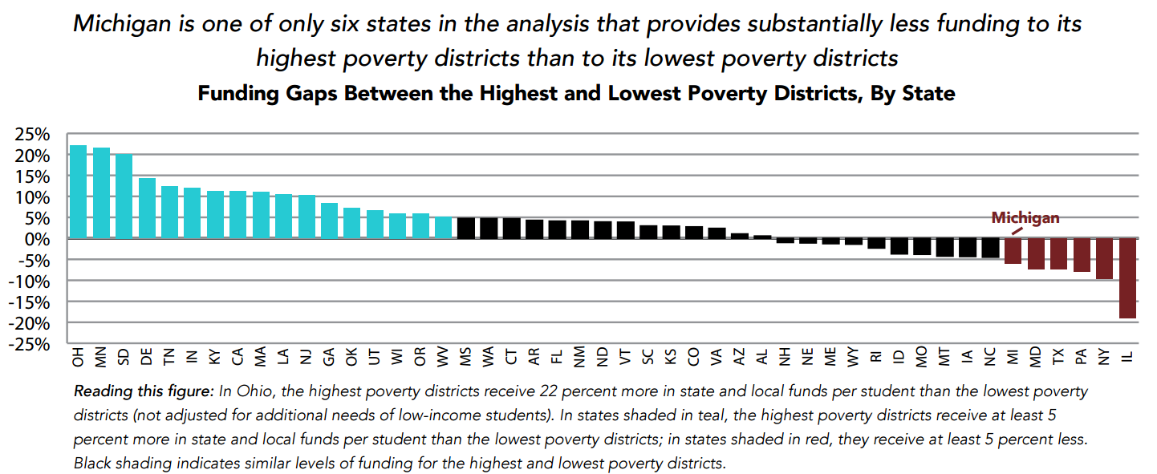
Michigan’s Funding Gap Between the Highest and Lowest Poverty Districts is 42nd Out of 47 States
Note: Hawaii was excluded from the within-state analysis because it is one district. Alaska and Nevada are also excluded because their student populations are heavily concentrated in certain districts and could be broken into quartiles. Because so many of New York’s students are concentrated in New York City, the analysis sorted that state into two halves, as opposed to four quartiles.
Source: The Education Trust, Funding Gaps Report, 2015

Slide 77
Funding Gaps Within Michigan:
Inequities in State and Local Revenue per Student
77
 | Gap
Highest-Poverty vs. Lowest-Poverty Districts | –$664, (per student) or 6%, less
Source: Natasha Ushomirksy and David Williams, “Funding Gaps 2015,” The Education Trust, 2015.

Slide 78
Recommendations for Michigan:
Find resources now for strategic state investments in systems improvement strategies, including training and supports around early literacy; standards implementation for teachers and school leaders, and quality evaluation.
Begin the process of overhauling the school funding system as necessary to assure fairness across different kinds of districts.

Slide 79
6. Beyond Funding, Aggressively Address Other Inequities That Contribute to Michigan’s Large Achievement Gaps

Slide 80
While many Americans believe that achievement gaps are mostly about the kids and their parents, research tells us otherwise.

Slide 81
When it comes to poor and minority students, we:
Expect less from them;
Educate them disproportionately in watered down courses; and,
Assign them disproportionately to our least experienced, least well-educated and least effective teachers.

Slide 82
We’re also more likely to suspend them from school, even for exactly the same offenses as more advantaged children.
And Michigan seems to have a particular problem…

Slide 83
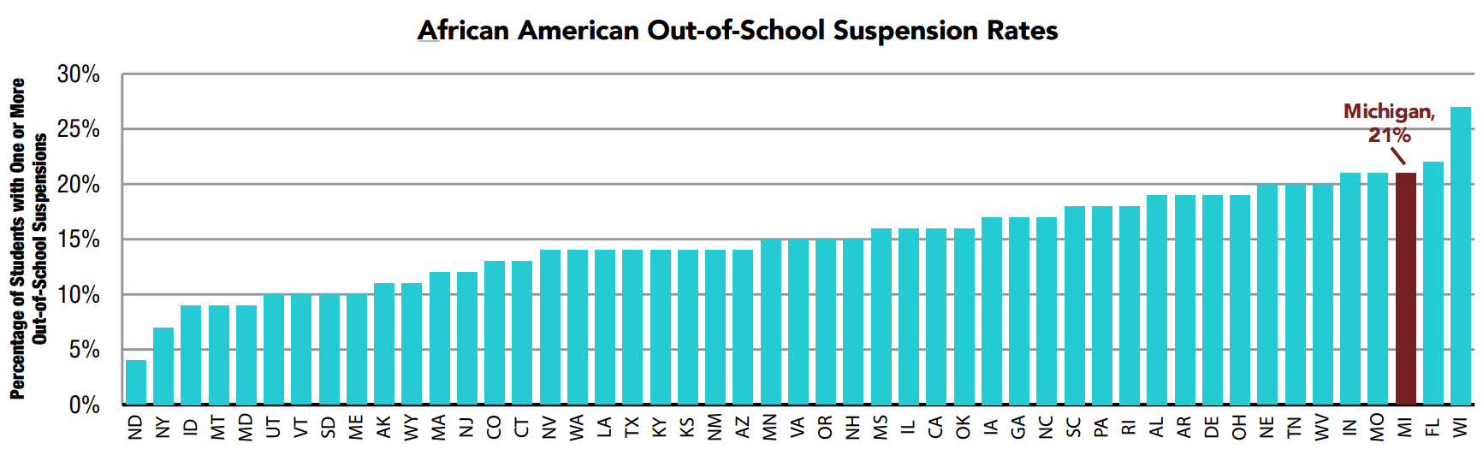
Michigan Has 3rd Highest Out-of-School Suspension Rate in the Nation for African American Students at 21%
*Note: Hawaii provided limited data and is excluded from this analysis.
2011 CRDC

Slide 84
Recommendations for Michigan:
Hold school districts (and schools) accountable for:
Ensuring fair access to the strongest teachers;
Ensuring equitable access to the rigorous high school courses that lead to readiness for college and careers; and,
Using discipline policies fairly, and focusing them on keeping students in school.
Organize vehicles for schools struggling with these issues to get advice and assistance from those that have successfully tackled them.

Slide 85
7. Speaking of accountability, take advantage of the flexibility—and leverage—in the new ESSA law to design a robust accountability system.

Slide 86
In education, as in other matters, accountability systems are critically important.
Good ones set clear goals, signal to both schools and the public when progress is adequate, and assure action in schools that are low performing and not improving, either for students overall or for any student group.

Slide 87
Recommendations for Michigan:
Ten Principles for Equity- and Improvement-Focused Accountability Systems
Focuses on improvement for all students in all schools.
Makes the main thing the main thing.
Sets clear improvement expectations both for students overall and for every group of young people.
Clearly communicates to families, educators, students and the public whether schools are meeting expectations for all groups of students.
Expects immediate action whenever any group of students is struggling.

Slide 88
Generates additional data to inform the improvement process.
Incentivizes and supports evidence-based solutions.
Makes families full partners in the improvement process.
Holds districts accountable for doing the parts that only they can do.
Keeps close tabs on progress and doesn’t keep kicking the can down the road.

Slide 89
And, by the way, you clearly need accountability for all kinds of schools and “districts.”
That includes charter schools, operators and authorizers.

Slide 90
No, accountability systems don’t produce improved achievement: only the hard work of teachers and administrators can.
But good school leaders will tell you that, just as low standards undermines good teaching, weak accountability undermines school improvement.

Slide 91
8. All of this requires committed and sustained State Leadership.

Slide 92
Recommendations for Michigan:
State leaders should engage the best experts from inside and outside of the state to help re-engineer the state’s improvement structures to provide better support to schools and districts.
Better use of data and the creation of fast-cycle feedback loops must be at the heart of the new system, so our efforts support continuous improvement and get smarter over time.
New resources should be focused on high-leverage, targeted strategies to improve system performance and student achievement, but quality implementation is essential.

Slide 93
Michigan Achieves: Key Priorities Moving Forward
Strong Reading Skills for All Michigan Third Graders
Committed and Sustained State Leadership
College- and Career-Ready Instruction for All Students
Strong Leaders and Excellent Teachers
Fair School Funding
TOP TEN EDUCATION STATE BY 2030
Honest and Reliable Data
Improved Access and Opportunity for All Students
Notes:
These outline the next steps where Michigan needs to take

Slide 94

THANK YOU!
Contact:
Jason Mancini, jmancini@edtrustmidwest.org
Suneet Bedi, sbedi@edtrustmidwest.org
The Education Trust – Midwest
(734) 619-8008
edtrustmidwest.org
michiganachieves.com

