Slide 1

March 31, 2017 | Leadership New Mexico | Hobbs, NM
Achievement and Opportunity in America (and New Mexico):
Critical Next Steps
© Copyright 2017 The Education Trust

Slide 2
America: Two Powerful Stories

Slide 3
1. Land of Opportunity:
Work hard, and you can become anything you want to be.

Slide 4
2. Generational Advancement:
Through hard work, each generation of parents can assure a better life — and better education — for their children.

Slide 5
These stories animated hopes and dreams of people here at home
And drew countless immigrants to our shores

Slide 6
Yes, America was often intolerant…
And they knew the “Dream” was a work in progress.

Slide 7
We were:
The first to provide universal high school;
The first to build public universities;
The first to build community colleges;
The first to broaden access to college, through GI Bill, Pell Grants, …

Slide 8



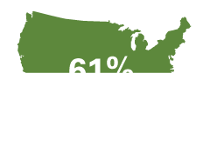
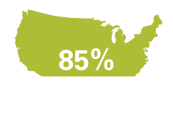
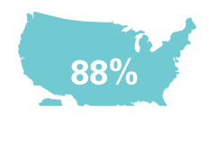
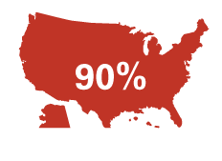
Percent of U.S. adults with a high school diploma
1920
1940
1960
1980
2000
2012

Slide 9

Percent of U.S. adults with a B.A. or more
1920
1940
1960
1980
2000
2012
11%
23%
29%
6%
4%
33%

Slide 10
Progress was painfully slow, especially for people of color. But year by year, decade by decade…

Slide 11
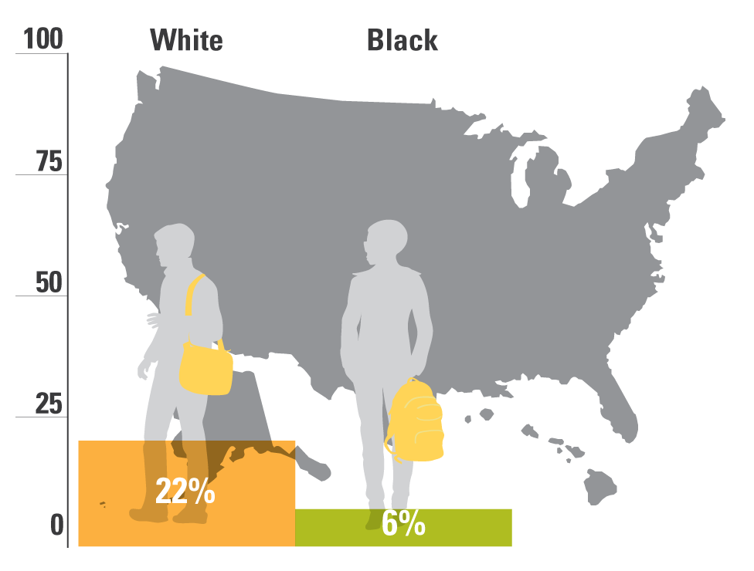
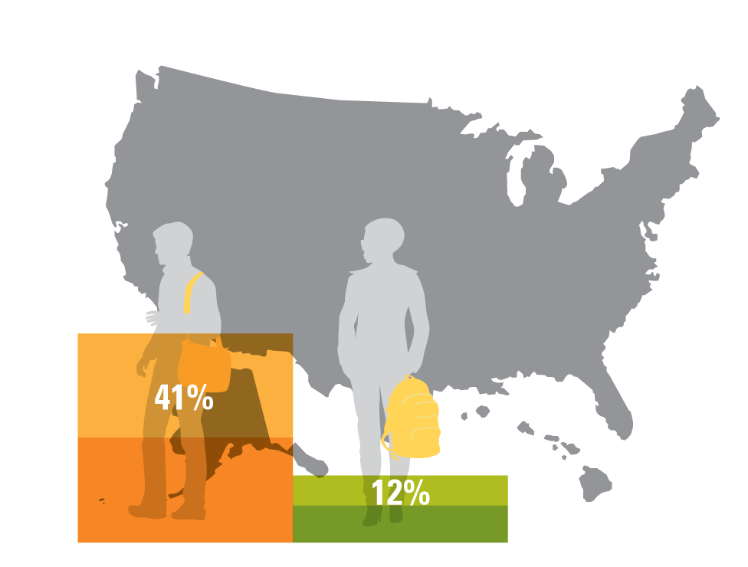
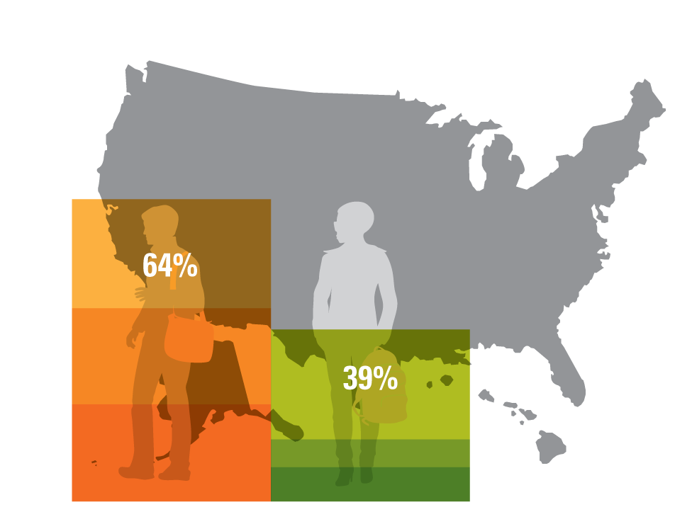
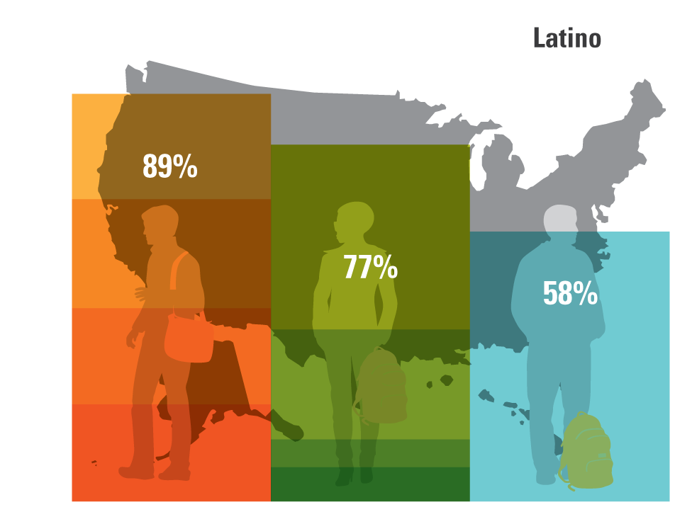
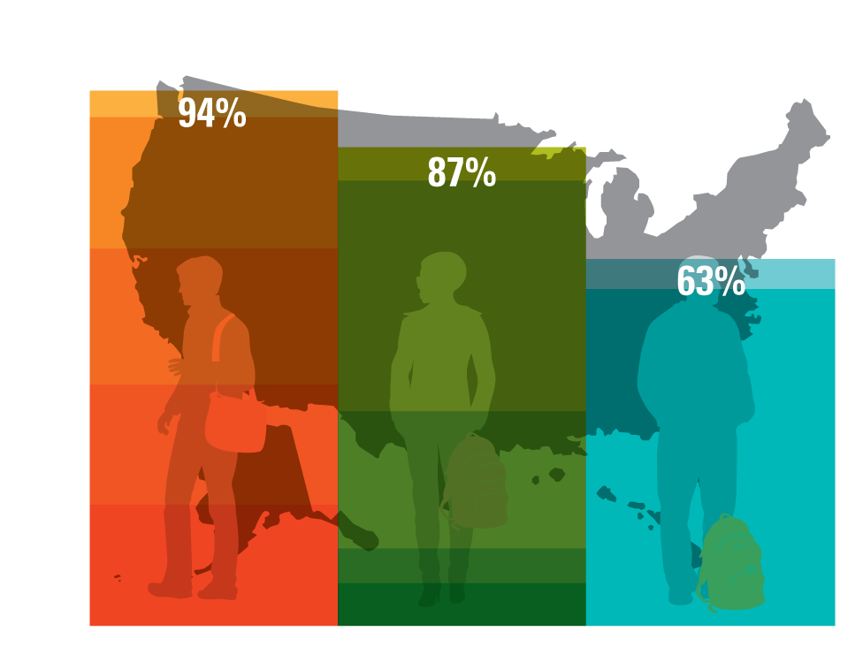
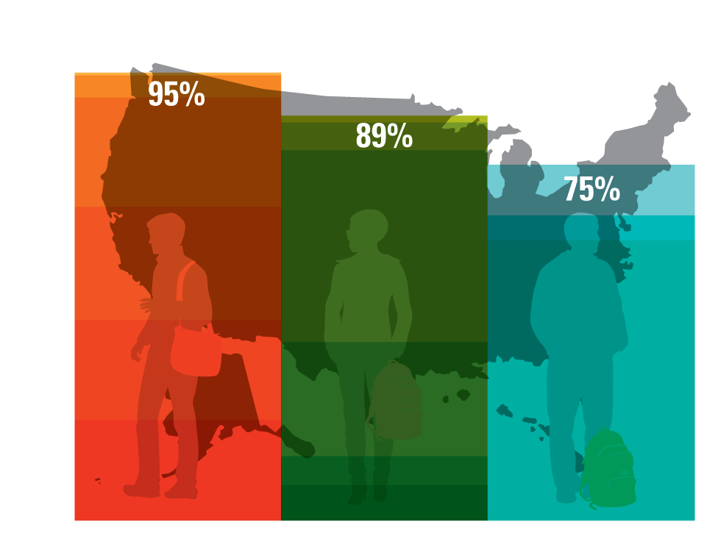
Percent of U.S. adults with a high school diploma, by race
1940
1920
1960
1980
2000
2012

Slide 12
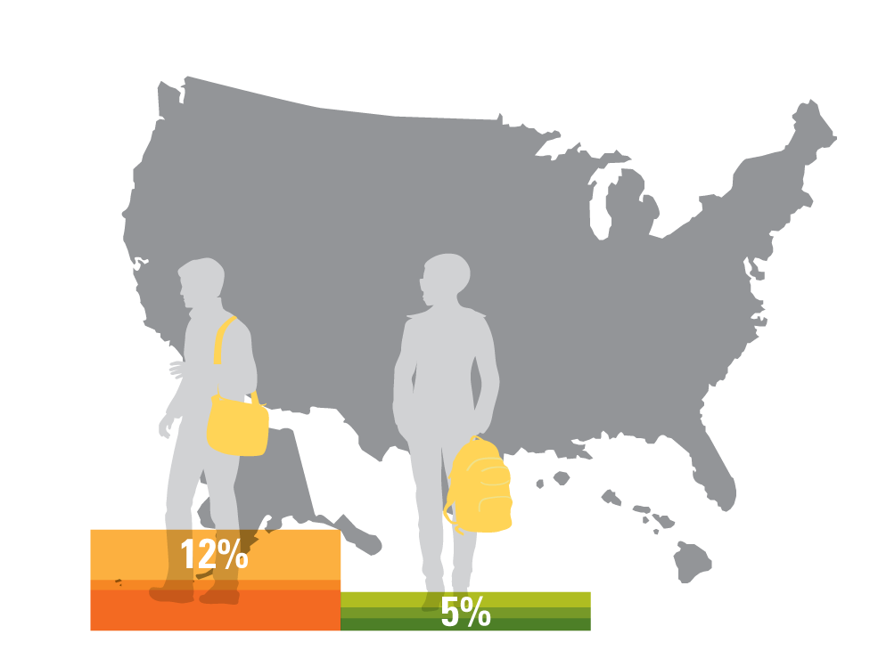
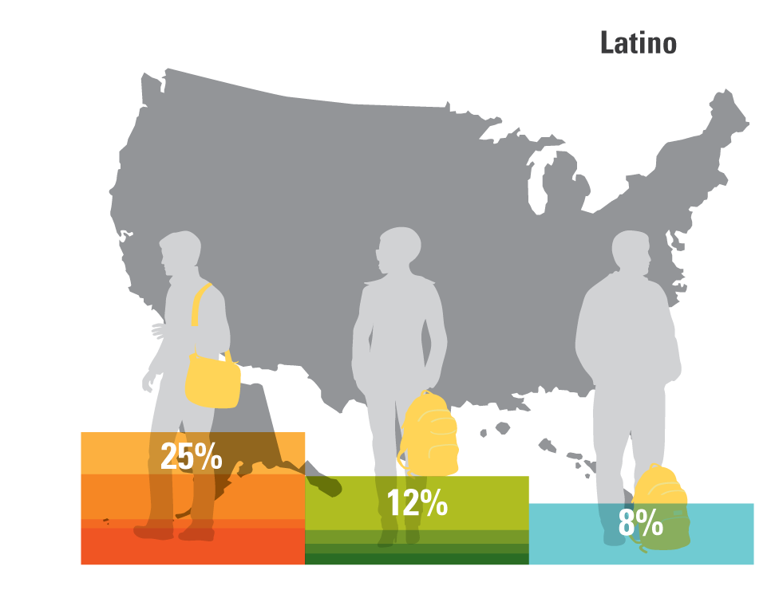
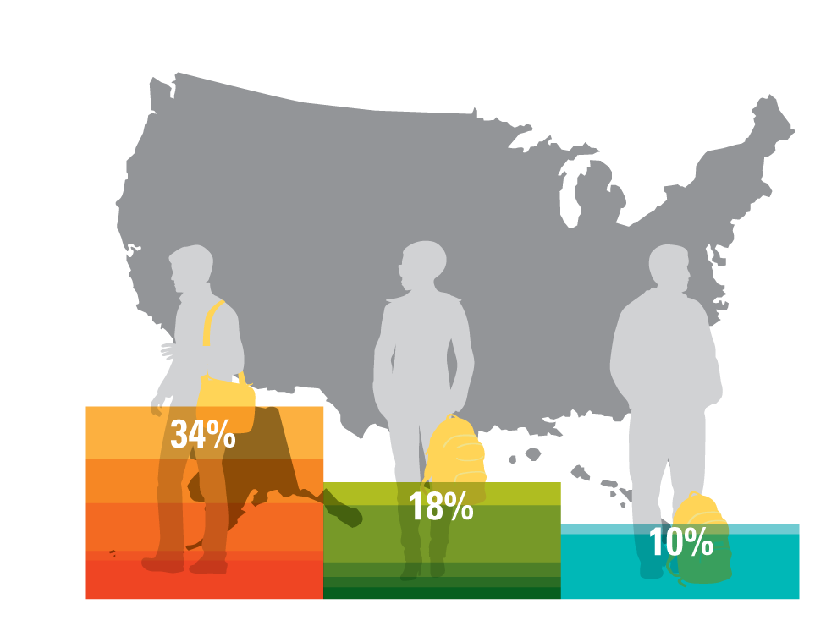
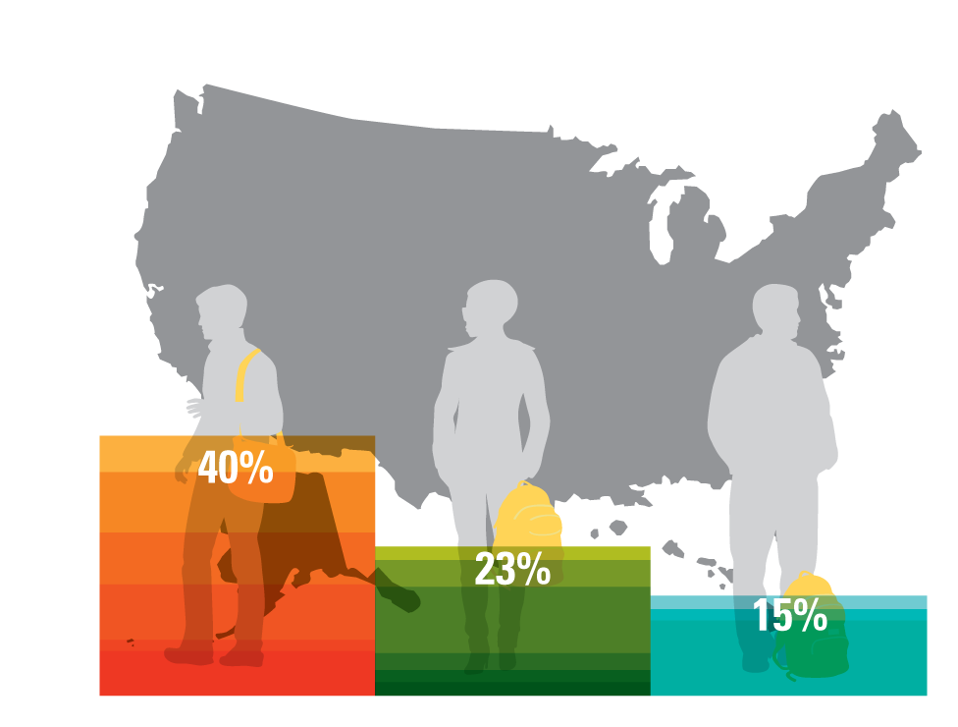
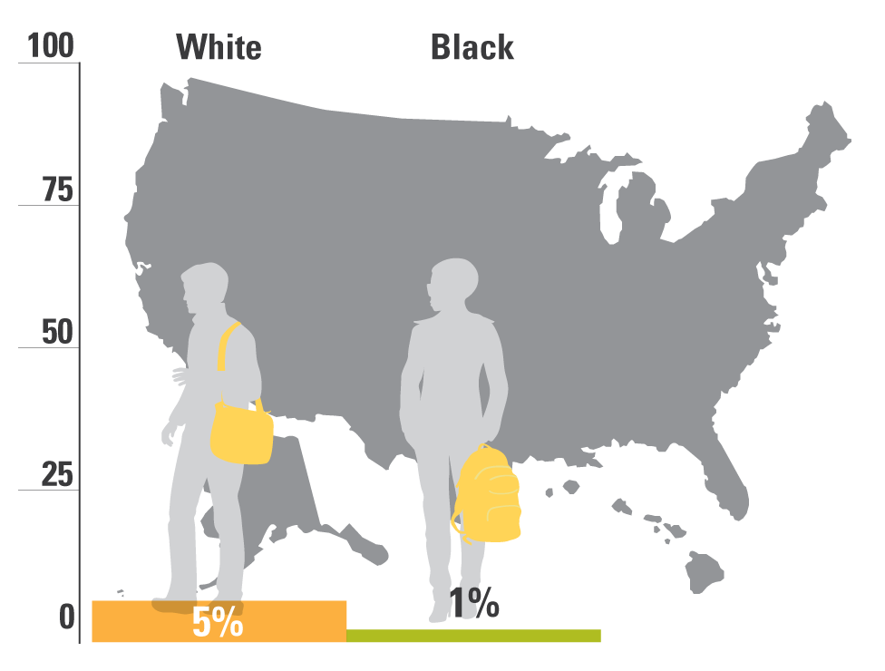

Percent of U.S. adults with a B.A. or more, by race
1960
1980
2000
2012
1920
1940

Slide 13
Then, beginning in the eighties, growing economic inequality started eating away at our progress.

Slide 14
In recent years, most income gains have gone to those at the top of the ladder, while those at the bottom have fallen backwards.
Source: Stiglitz, “Inequality is a Choice,” New York Times, October 13, 2013.

Slide 15
Wealthiest US households take greater share of income, while poorest 20% fall backwards
Source: U.S. Census Bureau, Current Population Survey Annual Social and Economic Supplements, Table H-2. Share of Aggregate Income Received by Each Fifth and Top 5 Percent of Households, All Races: 1967 to 2014.
Notes:
Updated 12/3/15 DEB
https://www.census.gov/hhes/www/income/data/historical/household/?cssp=SERP
Checked 1/8/14 JY
Updated 10/29/13 MW
http://www.census.gov/hhes/www/income/data/historical/household/

Slide 16
Instead of being the most equal, the U.S. has the third highest income inequality among OECD nations.
United States
Note: Gini coefficient ranges from 0 to 1, where 0 indicates total income equality and 1 indicates total income inequality.
Source: United Nations, U.N. data, http://data.un.org/DocumentData.aspx?q=gini&id=271: 2011

Slide 17
Not just wages and wealth, but social mobility as well.

Slide 18
U.S. intergenerational mobility was improving until 1980, but barriers have gotten higher since.
Source: Daniel Aaronson and Bhashkar Mazumder. Intergenerational Economic Mobility in the U.S.,1940 to 2000. Federal Reserve Bank of Chicago WP 2005-12: Dec. 2005.
Notes:
From the Aaronson and Mazumder report: “In particular, mobility increased from 1940 to 1980, but fell sharply during the 1980s and failed to revert, perhaps even continued to decline, in the 1990s.”
From the Aaronson and Mazumder report, the figure for 2000 (0.58) is not statistically significant. The figure for 1990 (0.46) almost mirrors the number cited for the US in the cross-country analysis on the next slide.

Slide 19
The US now has one of lowest rates of intergenerational mobility
Source: Corak, Miles. Chasing the Same Dream, Climbing Different Ladders. Economic Mobility Project; Pew Charitable Trusts, 2010.
Notes:
Checked 1/8/14 JY
Updated 11/14/13 MW

Slide 20
At macro level, better and more equal education is not the only answer.
But at the individual level, it really is.

Slide 21
There is one road up, and that road runs through our schools and colleges.

Slide 22

So, how are we doing?

Slide 23
First, some good news.
After more than a decade of fairly flat achievement and stagnant or growing gaps in K-12, we appear to be turning the corner with our elementary students.

Slide 24
Since 1999, large gains for all groups of students, especially students of color
*Denotes previous assessment format
National Center for Education Statistics, “The Nation's Report Card: Trends in Academic Progress 2012”

Slide 25
Since 1999, performance rising for all groups of students
*Denotes previous assessment format
National Center for Education Statistics, “The Nation's Report Card: Trends in Academic Progress 2012”

Slide 26
Looked at differently…

Slide 27
1996 NAEP Grade 4 Math
National Center for Education Statistics, NAEP Data Explorer, http://nces.ed.gov/nationsreportcard/nde/

Slide 28
2015 NAEP Grade 4 Math
National Center for Education Statistics, NAEP Data Explorer, http://nces.ed.gov/nationsreportcard/nde/

Slide 29
Middle grades are up, too.

Slide 30
Record performance for students of color
*Denotes previous assessment format
National Center for Education Statistics, “The Nation's Report Card: Trends in Academic Progress 2012”

Slide 31
Over the last decade, all groups have steadily improved and gaps have narrowed
*Accommodations not permitted
NAEP Data Explorer, NCES (Proficient Scale Score = 299)

Slide 32

Bottom Line:
When we really focus on something, we make progress!

Slide 33
Clearly, much more remains to be done in elementary and middle school
Too many youngsters still enter high school way behind.

Slide 34
But at least we have some traction on elementary and middle school problems.
The same is NOT true
of our high schools.

Slide 35
Achievement is flat in reading for students overall.
NAEP Long-Term Trends, NCES (2004)

Slide 36
Math achievement for students overall is flat over time.
* Denotes previous assessment format
National Center for Education Statistics, NAEP 2008 Trends in Academic Progress

Slide 37
And despite earlier improvements, gaps between groups haven’t narrowed much since the late 80s and early 90s.

Slide 38
Reading: Not much gap narrowing since 1988.
*Denotes previous assessment format
National Center for Education Statistics, “The Nation's Report Card: Trends in Academic Progress 2012”

Slide 39
Math: Not much gap closing since 1990.
*Denotes previous assessment format
National Center for Education Statistics, “The Nation's Report Card: Trends in Academic Progress 2012”

Slide 40
Moreover, no matter how you cut the data, our students aren’t doing well compared with their peers in other countries.

Slide 41
Of 35 OECD Countries, U.S.A. Ranks 19th in Science Literacy
U.S.A.
OECD
Higher than U.S. average Not measurably different from U.S. average Lower than U.S. average
National Center for Education Statistics, 2016 https://nces.ed.gov/surveys/pisa/pisa2015/pisa2015highlights_3.asp

Slide 42
Of 35 OECD Countries, U.S.A. Ranks 20th^{th} in Reading Literacy
U.S.A.
OECD
Average scale score
Higher than U.S. average Not measurably different from U.S. average Lower than U.S. average
National Center for Education Statistics, 2016 https://nces.ed.gov/surveys/pisa/pisa2015/pisa2015highlights_4.asp

Slide 43
Of 35 OECD Countries, U.S.A. Ranks 31st in Math Literacy
OECD
U.S.A.
Higher than U.S. average Not measurably different from U.S. average Lower than U.S. average
National Center for Education Statistics, 2016 https://nces.ed.gov/surveys/pisa/pisa2015/pisa2015highlights_5.asp

Slide 44
Up until the latest results, the only place we ranked high was someplace we didn’t want to rank high: Inequality!
But we made a little progress there.

Slide 45
The gap between high and low-SES students in the United States is slightly smaller than the OECD average.
U.S.A.
OECD
Gap in Average Scale Score
Note: High SES students are those in the top quartile on the ESCS. Low SES students are those in the bottom quartile. The ESCS (Index of Economic, Social, and Cultural Status) is comprised of information related to parents’ occupational status, parents’ educational attainment, family wealth, home educational resources, and possessions related to “classical” culture in the home.
National Center for Education Statistics, 2016 https://nces.ed.gov/surveys/pisa/pisa2015/pisa2015highlights_4.asp
Notes:
According to the OECD, 30 scale score points is equivalent to a year’s worth of schooling. The US gap is roughly 78 points.

Slide 46
The U.S. Gap Between High-SES and Low-SES Students is Equivalent to Over Two Years of Schooling
OECD
U.S.A.
Note: High SES students are those in the top quartile on the ESCS. Low SES students are those in the bottom quartile. The ESCS (Index of Economic, Social, and Cultural Status) is comprised of information related to parents’ occupational status, parents’ educational attainment, family wealth, home educational resources, and possessions related to “classical” culture in the home.
National Center for Education Statistics, 2016 https://nces.ed.gov/surveys/pisa/pisa2015/pisa2015highlights_5.asp
Notes:
According to the OECD, 30 scale score points is equivalent to a year’s worth of schooling. The US gap is roughly 86 points.

Slide 47
The U.S. Gap Between High-SES and Low-SES Students is Equivalent to Over Two Years of Schooling
OECD
U.S.A.
Note: High SES students are those in the top quartile on the ESCS. Low SES students are those in the bottom quartile. The ESCS (Index of Economic, Social, and Cultural Status) is comprised of information related to parents’ occupational status, parents’ educational attainment, family wealth, home educational resources, and possessions related to “classical” culture in the home.
National Center for Education Statistics, 2016 https://nces.ed.gov/surveys/pisa/pisa2015/pisa2015highlights_3.asp
Notes:
According to the OECD, 30 scale score points is equivalent to a year’s worth of schooling. The US gap is roughly 90 points.

Slide 48
PISA results indicate that U.S. schools are equipping white and Asian students with higher levels of preparation in reading.
Average scale score
National Center for Education Statistics, 2016 https://nces.ed.gov/surveys/pisa/pisa2015/pisa2015highlights_4.asp

Slide 49
PISA results indicate that U.S. schools are equipping white and Asian students with higher levels of preparation in Math.
National Center for Education Statistics, 2016 https://nces.ed.gov/surveys/pisa/pisa2015/pisa2015highlights_5.asp

Slide 50
PISA results indicate that U.S. schools are equipping white and Asian students with higher levels of preparation in science.
National Center for Education Statistics, 2016 https://nces.ed.gov/surveys/pisa/pisa2015/pisa2015highlights_3.asp

Slide 51
So let’s talk about those gaps.

Slide 52
Gaps in achievement begin before children arrive at the schoolhouse door.
But, rather than organizing our educational system to ameliorate this problem, we organize it to exacerbate the problem.

Slide 53
How?
By giving students who arrive with less, less in school, too.

Slide 54
Some of these “lesses” are a result of choices that policymakers make.

Slide 55
National Inequities in State and Local Revenue Per Student
 | Gap
High Poverty vs. Low Poverty Districts | –$1200 per student
High Minority vs. Low Minority Districts | –$2,000 per student
Education Trust analyses based on U.S. Dept of Education and U.S. Census Bureau data for 2010-12

Slide 56
In truth, though, some of the most devastating “lesses” are a function of choices that we educators (and school board members) make.

Slide 57

Choices we make about what to expect of whom.....

Slide 58
Students in poor schools receive As for work that would earn Cs in affluent schools.
Source: Prospects (ABT Associates, 1993), in “Prospects: Final Report on Student Outcomes”, PES, DOE, 1997.

Slide 59
Choices we make about what to teach whom…

Slide 60
Even African-American students with high math performance in fifth grade are unlikely to be placed in algebra in eighth grade
Source: NCES, “Eighth-Grade Algebra: Findings from the Eighth-Grade Round of the Early Childhood Longitudinal Study, Kindergarten Class of 1998-99 (ECLS-K)” (2010).

Slide 61
And choices we make about who teaches whom…

Slide 62
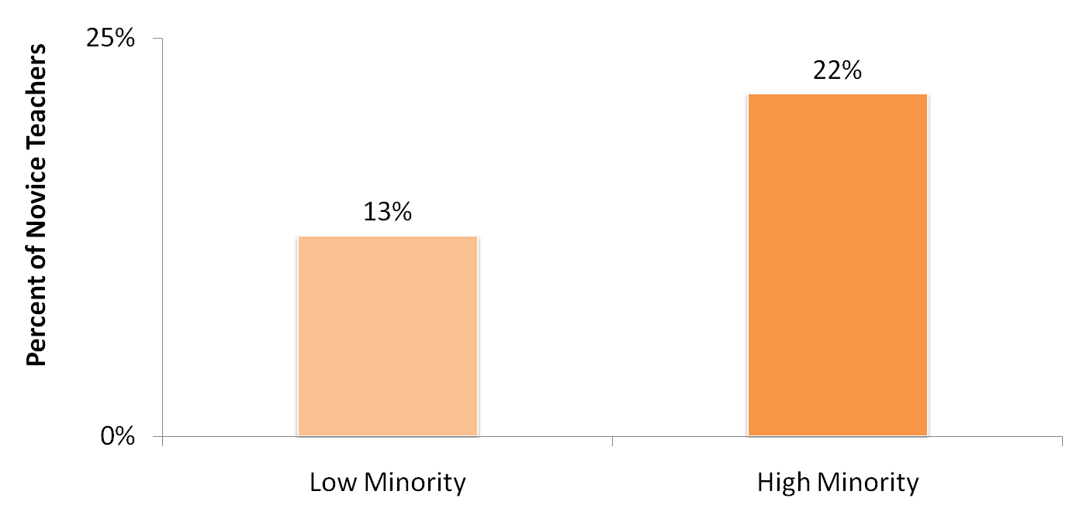
Students at high-minority schools more likely to be taught by novice* teachers.
Note: High minority school: 75% or more of the students are Black, Hispanic, American Indian or Alaskan Native, Asian or Pacific Islander. Low-minority school: 10% or fewer of the students are non-White students. Novice teachers are those with three years or fewer experience.
Source: Analysis of 2003-2004 Schools and Staffing Survey data by Richard Ingersoll, University of Pennsylvania 2007.
Notes:
Data is from the 2003-2004 Schools & Staffing Survey (SASS)
SASS surveys a nationally representative sample of teachers.
Analysis examines out-of-field teaching in core academic classes at secondary & middle school:
Core academic classes are English, math, social studies and science.
“Out-of-field” is defined as a teacher lacking both an in-field regular certification and a major in the subject of the classes she/he was assigned to teach
Secondary classes include departmentalized classes in grades 7-12.
Middle grades include 5-8. Only teachers assigned to departmentalized classes count towards middle grades.

Slide 63
Math classes at high-poverty, high-minority secondary schools are more likely to be taught by out-of-field* teachers.
Note: High-poverty school: 55 percent or more of the students are eligible for free/reduced-price lunch. Low-poverty school :15 percent or fewer of the students are eligible for free/reduced-price lunch. High-minority school: 78 percent or more of the students are black, Hispanic, American Indian or Alaskan Native, Asian or Pacific Islander. Low-minority school : 12 percent or fewer of the students are non-white students.
*Teachers with neither certification nor major. Data for secondary-level core academic classes (math, science, social studies, English) across the U.S.
Source: Education Trust Analysis of 2007-08 Schools and Staffing Survey data.
Notes:
Data is from the 2003-2004 Schools & Staffing Survey (SASS)
SASS surveys a nationally representative sample of teachers.
Analysis examines out-of-field teaching in core academic classes at secondary & middle school:
Core academic classes are English, math, social studies and science.
“Out-of-field” is defined as a teacher lacking both an in-field regular certification and a major in the subject of the classes she/he was assigned to teach
Secondary classes include departmentalized classes in grades 7-12.
Middle grades include 5-8. Only teachers assigned to departmentalized classes count towards middle grades.

Slide 64
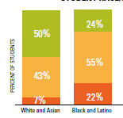
Los Angeles: Black, Latino students have fewer highly effective teachers, more weak ones.
READING/LANGUAGE ARTS
Latino and black students are:
3X as likely to get low- effectiveness teachers
½ as likely to get highly effective teachers
Source: Education Trust—West, Learning Denied, 2012.

Slide 65
The results are devastating.
Kids who come in a little behind, leave a lot behind.

Slide 66
And these are the students who remain in school through 12th grade.

Slide 67
Students of color are less likely to graduate from high school on time.
Source: National Center for Education Statistics, “Public School Graduates and Dropouts from the Common Core of Data: School Year 2008-09” (2011).

Slide 68
Add those numbers up and throw in college entry and graduation, and different groups of young Americans obtain degrees and very different rates…

Slide 69
Whites attain bachelor’s degrees at nearly twice the rate of blacks and almost three times the rate of Hispanics
Source: U.S. Census Bureau, Educational Attainment in the United States: 2014
Notes:
Updated 1/15/16 DEB
Updated 1/28/14 MW with 2013 data
MNB confirmed 1/7/2014

Slide 70
Young adults from high-income families are more than three times as likely as those from low-income families to earn bachelor’s degrees by age 24
http://www.brookings.edu/research/papers/2015/03/12-chalkboard-income-education-attainment-chingos
Notes:
DEB updated 2/29/16
MNB confirmed 1/7/14
Possible update - Subscription to Postsecondary Education Opportunity?

Slide 71
These rates threaten the health of our democracy.
But even for those who don’t care much about that, the rates are particularly worrisome, given which groups are growing — and which aren’t.

Slide 72
Changing demographics demand greater focus on underrepresented populations.
Population Increase, Ages 0–24,
(in thousands)
Percentage Increase, Ages 0–24
Closing racial gaps in degree attainment will create more than half the degrees
necessary to raise America to first in the world in degree attainment.
Note: Projected Population Growth, Ages 0–24, 2010-2050
Source: National Population Projections, U.S. Census Bureau. Released 2008; NCHEMS, Adding It Up, 2007.

Slide 73
Given these patterns, it is not surprising that our international standing is slipping.

Slide 74
We’re relatively strong in educational attainment.
Note: Adults with a postsecondary degree include those who have completed either a tertiary-type B program (programs that last for at least two years, are skill-based, and prepare students for direct entry into the labor market) or a tertiary-type A program (programs that last at least three, but usually four, years, are largely theory-based, and provide qualifications for entry into highly skilled professions or advanced research programs).
Source: Organisation for Economic Co-operation and Development, Education at a Glance 2011 (2011)

Slide 75
Our world standing drops to 15th for
younger workers.
United States
OECD Average
Note: Adults with a postsecondary degree include those who have completed either a tertiary-type B program (programs that last for at least two years, are skill-based, and prepare students for direct entry into the labor market) or a tertiary-type A program (programs that last at least three, but usually four, years, are largely theory-based, and provide qualifications for entry into highly-skilled professions or advanced research programs).
Source: Organisation for Economic Co-operation and Development, Education at a Glance 2011 (2011)

Slide 76
We’re near the bottom in intergenerational progress.
OECD Average
United States
Note: Adults with a postsecondary degree include those who have completed either a tertiary-type B program (programs that last for at least two years, are skill-based, and prepare students for direct entry into the labor market) or a tertiary-type A program (programs that last at least three, but usually four, years, are largely theory-based, and provide qualifications for entry into highly-skilled professions or advanced research programs).
Source: Organisation for Economic Co-operation and Development, Education at a Glance 2011 (2011)

Slide 77
What Can We Do?
An awful lot of Americans have decided that we can’t do much.

Slide 78
What We Hear Many Educators Say:
They’re poor
Their parents don’t care
They come to schools without breakfast
Not enough books
Not enough parents
N/A

Slide 79
Let’s be clear, these things do matter.

Slide 80
Child Poverty in the US, 2013
White | 13.4%
Black | 36.9%
Hispanic | 30.4%
Asian | 9.6%
ALL | 19.9%
Source: US Census Bureau

Slide 81
And let’s also be clear: tolerating high child poverty rates is a policy choice. Though we remain the richest nation on earth…

Slide 82
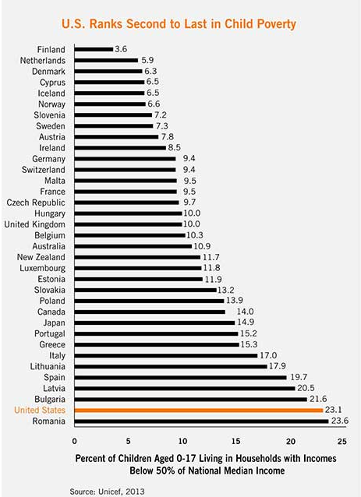

Slide 83
Yet, how we respond to the effects of that choice is a choice, too.

Slide 84
We can choose to go along with what has become conventional wisdom in our profession—that, until we fix poverty, there’s not much we educators can do…

Slide 85
Or we can choose differently.
…joining colleagues in schools all over this country that serve very poor kids but get very good results.

Slide 86
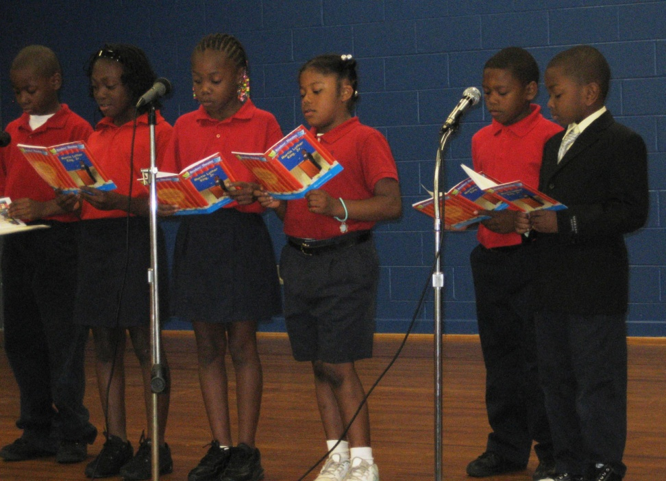
George Hall Elementary School
Mobile, Alabama
549 students in grades PK-5
  99% African American
99% Low Income
Note: Enrollment data are for 2009-10 school year
Alabama Department of Education
Notes:
Updated

Slide 87
Big Improvement at George Hall Elementary
Alabama Department of Education

Slide 88
Exceeding Standards: George Hall students outperform white students in Alabama
Alabama Department of Education
Notes:
Updated

Slide 89
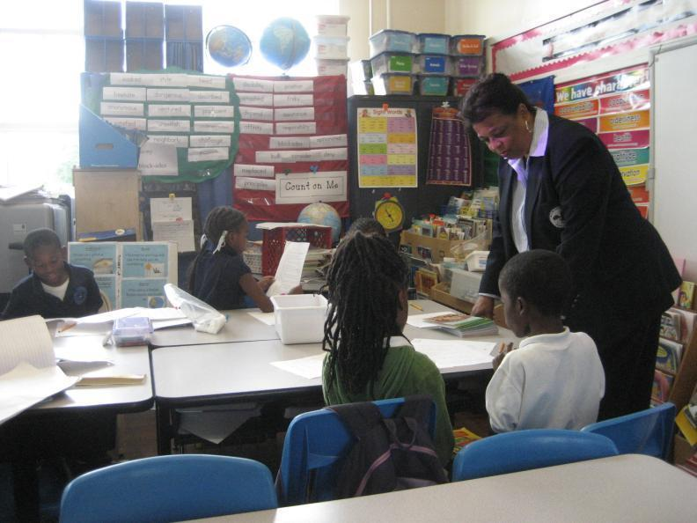
Mary McLeod Bethune Elementary School
New Orleans, Louisiana
505 students in grades PK – 6
99% African American
90% Low-Income
.
Source: Louisiana Department of Education, 2016

Slide 90
Bethune Elementary Outperforming the State
Source: Louisiana Department of Education

Slide 91
Bethune Elementary Outperforming the State
Source: Louisiana Department of Education

Slide 92
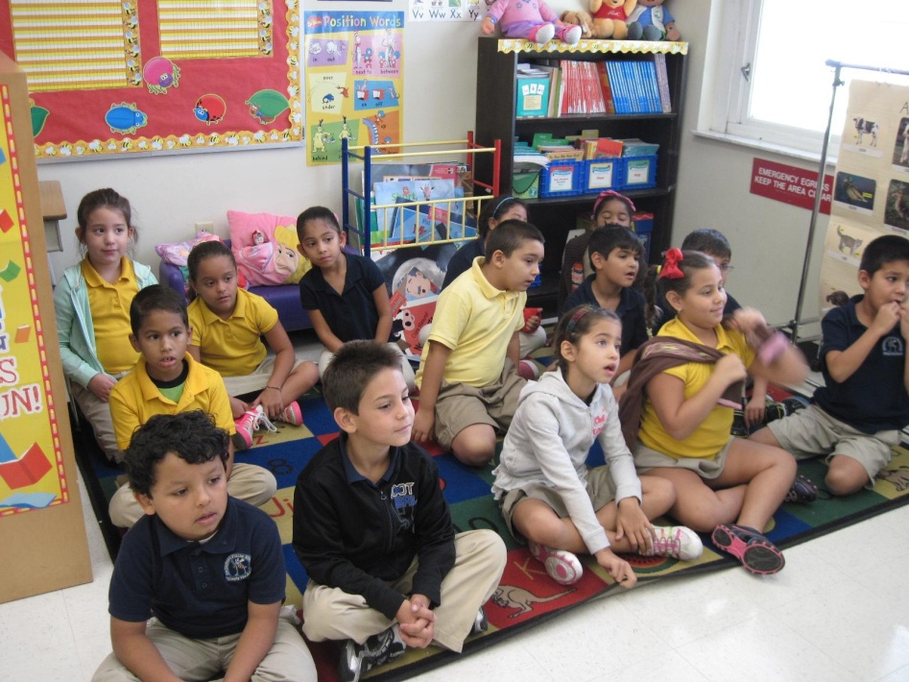
Dr. Carlos J. Finlay Elementary School
Miami-Dade, Florida
511 students in grades PK – 5
98% Latino
86% Low Income
57% English Language
Learners
Note: Data are for 2012-2013 school year.
Source: Florida Department of Education

Slide 93
Finlay Elementary Outperforming the State
Source: Florida Department of Education

Slide 94
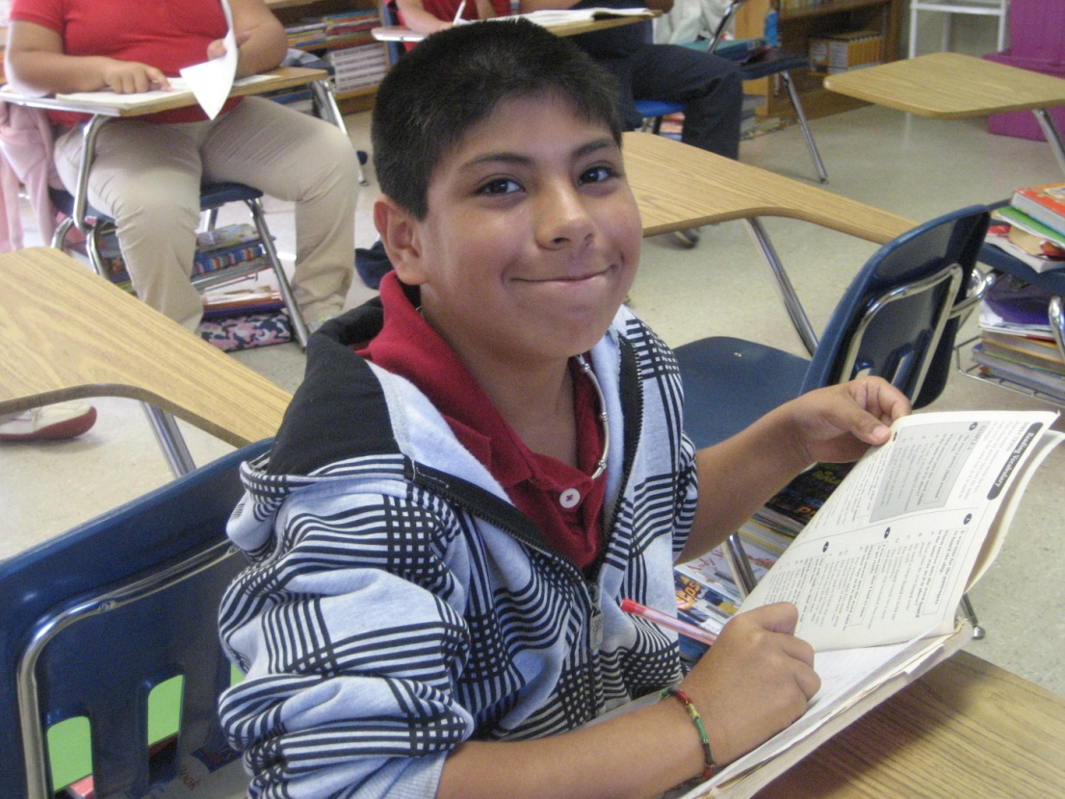
Calcedeaver Elementary School
Mount Vernon, AL
262 students in grades K – 6
  81% American Indian
  16% white
80% Low Income
Note: Data are for 2009-10 school year
Source: National Center for Education Statistics, Common Core of Data

Slide 95
Outperforming the State at
Calcedeaver Elementary
Source: Alabama State Department of Education

Slide 96
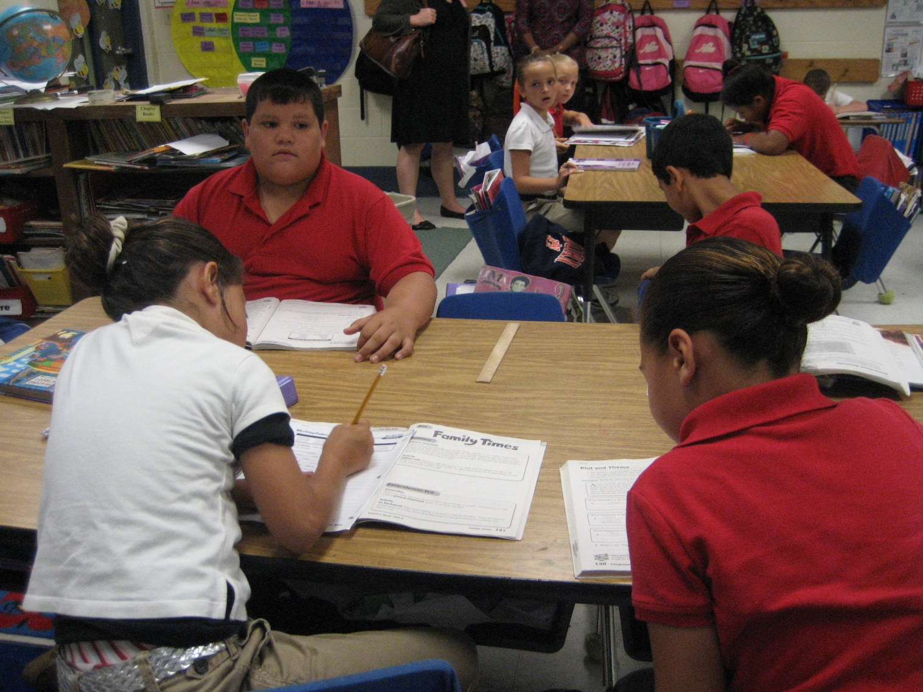

Slide 97
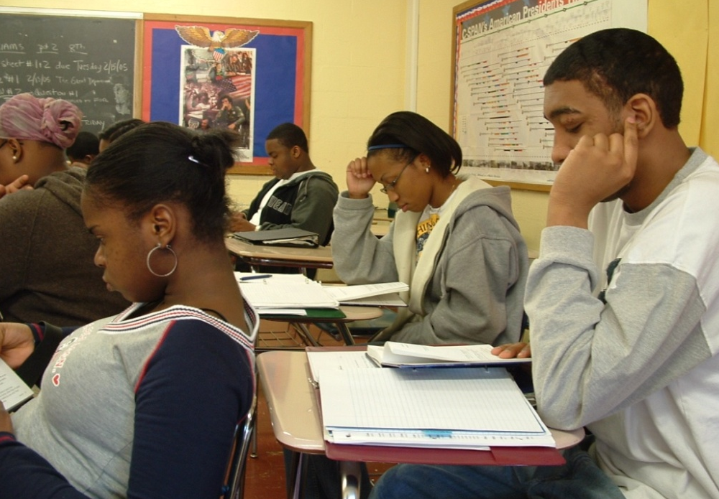
Elmont Memorial High School
Elmont, New York
1,739 students in grades 7-12
  76% African American
  14% Latino
  9% Asian
  1% White
New York State Department of Education,2016
Notes:
Let me give you a sense by introducing another school. All unexpected schools have systems of observing classroom instruction and using those observations to think about how to support teachers, but Elmont Memorial High School’s is perhaps the most sophisticated and explicit. And you can read a book about it as well – Diane Scricca and Albert Coppola, Supportive Supervision, Corwin Books.

Slide 98
High Performance by ALL Students at Elmont Memorial High School
New York Department of Education https://reportcards.nysed.gov/schools.php?district=800000049235&year=2012

Slide 99
High Performance by ALL Students at Elmont Memorial High School
New York Department of Education https://reportcards.nysed.gov/schools.php?district=800000049235&year=2012

Slide 100
New York State Department of Education, 2016
Notes:
Just to give you a sense, here are the graduation rates at Elmont – and…

Slide 101
This is what happens when teams of educators choose differently.

Slide 102
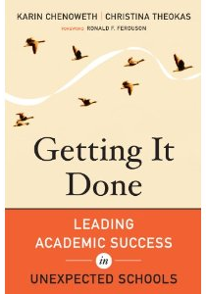


Available from
Harvard Education Press and amazon.com

Slide 103
Just flukes, outliers?
No. Very big differences at district level, too—even in the progress and performance of the “same” group of students.

Slide 104
Average Scale Scores, by District
Low-Income African American Students
Note: Basic Scale Score = 208; Proficient Scale Score = 238
NAEP Data Explorer, NCES

Slide 105
Average Scale Scores, by District
Low-Income Latino Students
Note: Basic Scale Score = 214; Proficient Scale Score = 249
NAEP Data Explorer, NCES

Slide 106
Bottom Line:
At every level of education—school, district and state—what we do matters.

Slide 107
Where is New Mexico in All of This?

Slide 108
Scale Scores by State – All Students
NAEP Data Explorer, NCES (Proficient Scale Score = 238; Basic Scale Score = 208)

Slide 109
Scale Scores by State – White Students
NAEP Data Explorer, NCES (Proficient Scale Score = 238; Basic Scale Score = 208)

Slide 110
Scale Scores by State – Latino Students
NAEP Data Explorer, NCES (Proficient Scale Score = 238; Basic Scale Score = 208)

Slide 111
Scale Scores by State –
American Indian/Alaska Native Students
NAEP Data Explorer, NCES (Proficient Scale Score = 238; Basic Scale Score = 208)

Slide 112
Scale Scores by State – All Students
NAEP Data Explorer, NCES (Proficient Scale Score = 299; Basic Scale Score = 262)

Slide 113
Scale Scores by State – White Students
NAEP Data Explorer, NCES (Proficient Scale Score = 299; Basic Scale Score = 262)

Slide 114
Scale Scores by State – Latino Students
NAEP Data Explorer, NCES (Proficient Scale Score = 299; Basic Scale Score = 262)

Slide 115
Scale Scores by State –
American Indian/Alaska Native Students
NAEP Data Explorer, NCES (Proficient Scale Score = 299; Basic Scale Score = 262)

Slide 116
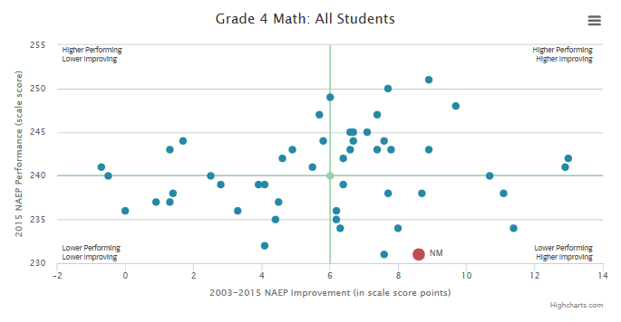
4th Grade Math, All Students:
New Mexico Higher Improving, But Still Lower Performing

Slide 117
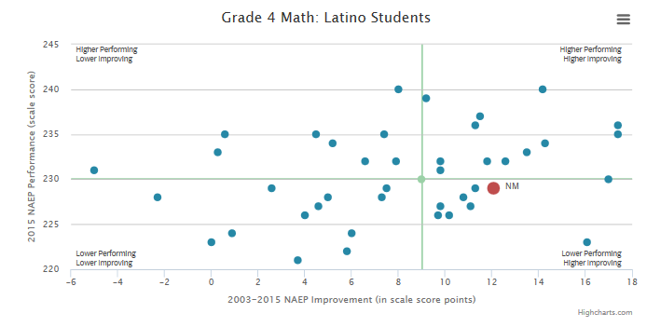
4th Grade Math, Latino Students: New Mexico Higher Improving, Average Performing

Slide 118
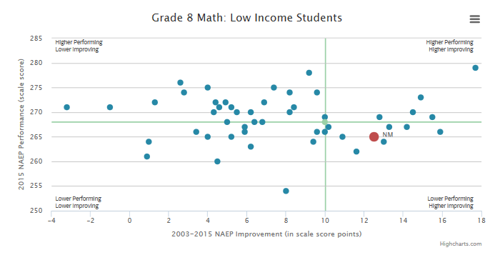
8th Grade Math, Low Income Students:
New Mexico Higher Improving, Average Performing

Slide 119
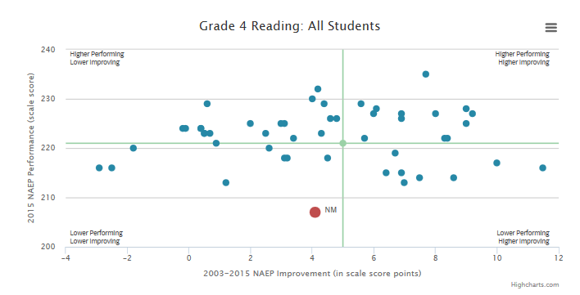
4th Grade Reading, All Students: New Mexico Medium Improver, Lower Performing

Slide 120
Strong improvements in recent years for American Indian students…

Slide 121
NAEP Grade 4 Math –
American Indian/Alaska Native Students
States with the Biggest Gains in Mean Scale Scores
(2003 – 2015)
State | Gain
Oklahoma | 10
North Dakota | 10
Arizona | 10
New Mexico | 8
Wisconsin | 8
#4
Note: On average, mean scale scores in math for American Indian/Alaska Native fourth-grade students increased by 4 points from 2003 to 2015.
Source: National Center for Education Statistics, NAEP Data Explorer

Slide 122
NAEP Grade 8 Math –
American Indian/Alaska Native Students
States with the Biggest Gains in Mean Scale Scores
(2003 – 2015)
State | Gain
New Mexico | 14
Arizona | 6
South Dakota | 5
#1
Note: On average, mean scale scores in math for American Indian/Alaska Native eighth-grade students increased by 3 points from 2003 to 2015.
Source: National Center for Education Statistics, NAEP Data Explorer

Slide 123
How is our biggest city doing to other cities across the country?

Slide 124
Average Scale Scores, by District
Students Overall
Note: Basic Scale Score = 208; Proficient Scale Score = 238
NAEP Data Explorer, NCES

Slide 125
Average Scale Scores, by District
Latino Students
Note: Basic Scale Score = 208; Proficient Scale Score = 238
NAEP Data Explorer, NCES

Slide 126
Average Scale Scores, by District
Low-Income Students
Note: Basic Scale Score = 208; Proficient Scale Score = 238
NAEP Data Explorer, NCES

Slide 127
Average Scale Scores, by District
Students Overall
Note: Basic Scale Score = 262; Proficient Scale Score = 299
NAEP Data Explorer, NCES

Slide 128
Average Scale Scores, by District
Latino Students
Note: Basic Scale Score = 262; Proficient Scale Score = 299
NAEP Data Explorer, NCES

Slide 129
Average Scale Scores, by District
Low-Income Students
Note: Basic Scale Score = 262; Proficient Scale Score = 299
NAEP Data Explorer, NCES

Slide 130
On the college side?

Slide 131
College Going Rate for Recent High School Graduates, 2012
Source: Digest of Education Statistics Table 302.5: Estimated rate of 2011-12 high school graduates attending degree-granting postsecondary institutions, by state: 2012
Notes:
Updated 6/21/16 KES
Title: Definition used by PEO is “College Continuation Rate”. Is this the same as the College going rate for recent HS grads?

Slide 132
When High School Dropout Rate is Factored In, the Picture is Different
(HS Grad Rate x College Continuation Rate, 2010)
Source: Postsecondary Education Opportunity, Chance for College by Age 19 by State, 1986-2010.
Notes:
Chance for College by Age 19
Updated 3/14/14 MW
*Data was not available to update this slide 6/21/16 KES

Slide 133
Success Rates For Those Who Enroll
4 year colleges

Slide 134
Six-Year College Graduation Rates, 2014
Source: Ipeds 2014
Notes:
6/20/16 KES UPDATED Using IPEDS 2014 (manually calculated)

Slide 135
Six-Year College Graduation Rates
White, 2014
Source: Ipeds, 2014.
Notes:
6/20/16 KES UPDATED Using IPEDS 2014 (manually calculated)

Slide 136
Six-Year College Graduation Rates
African American, 2014
Source: Ipeds, 2014
Notes:
6/20/16 KES UPDATED Using IPEDS 2014 (manually calculated)

Slide 137
Six-Year College Graduation Rates
Hispanic, 2014
Source: Ipeds, 2014
Notes:
6/20/16 KES UPDATED Using IPEDS 2014 (manually calculated)

Slide 138
Six-Year College Graduation Rates
American Indian/Alaska Native, 2014
Source: Ipeds, 2014
.
Notes:
6/20/16 KES UPDATED Using IPEDS 2014 (manually calculated)

Slide 139
And for those who start in 2-year colleges?

Slide 140
Three-Year College Graduation Rates, 2014
Source: Ipeds, 2014
Notes:
6/20/16 KES UPDATED Using IPEDS 2014 (manually calculated)

Slide 141
Add it all up?

Slide 142
Adults Ages 25-64 with at least an Associate’s Degree, 2014
Source: U.S. Census Bureau, 2014 American Community Survey data 5 YR estimates
Notes:
Updated 6/21/16 KES manually calculated
Note: These state-by-state statistics use a different data source (ACS) than the international degree attainment data (CPS), so the attainment rates are slightly different (41% in international slide using CPS, compared with 39% in state-by-state slide using ACS). If you show the international statistics, I recommend not showing this slide, so as not to create confusion.

Slide 143
Adults Ages 25-34 with at least an Associate’s Degree, 2014
Source: U.S. Census Bureau, 2014 American Community Survey 5yr estimates
Notes:
Updated 6/21/16 KES manually calculated
Note: These state-by-state statistics use a different data source (ACS) than the international degree attainment data (CPS), so the attainment rates are slightly different (41% in international slide using CPS, compared with 39% in state-by-state slide using ACS). If you show the international statistics, I recommend not showing this slide, so as not to create confusion.

Slide 144
Adults Ages 25-34 with at least a Bachelor’s Degree, 2014
Source: U.S. Census Bureau, 2014 American Community Survey 5yr estimates
Notes:
Updated 6/21/16 KES manually calculated

Slide 145
Differences between groups?

Slide 146
Gaps Between Whites and Minorities – Average Annual Percent of Adults 25+ with at Least an Associate’s Degree, 2011-2013
Source: US Census. 2013 American Community Survey 3-YR estimates. B15002H: Sex by educational attainment for the population 25 years and oveR (White, Hispanic, Native American, and Black).
Notes:
Updated 6/22/16 KES manually calculated
Had to use 2013 3-yr estimates, as they did not have 2014 5-yr estimates

Slide 147
Gaps Between Whites and Minorities – Average Annual Percent of Adults 25+ with at Least a Bachelor’s Degree, 2010-2014
Source: US Census. 2014 American Community Survey 5-YR estimates. B15002H: Sex by educational attainment for the population 25 years and over (White, Hispanic, Native American, and Black).
.
Notes:
Updated 6/22/16 KES manually calculated

Slide 148
What Can You Do?

Slide 149
First, don’t accept the excuses.

Slide 150
When you see troubling data on your schools or colleges, it doesn’t help if you just ignore it. You can help create demand for change by pointing to the successes elsewhere—and by pressing for similar results.

Slide 151
Yes, this may make you “annoying.” But in the end, you don’t do education leaders any favors by being too nice. The good ones will use your demands to leverage change. (And, if you are lucky, you’ll drive the bad ones out.)

Slide 152
Second, push your state and districts to start early, especially with low-income children.

Slide 153
High quality pre-school is the best investment we can make. It pays to prevent problems rather than ameliorate them later.

Slide 154
Third, get behind College and Career Ready Standards.
Earlier standards were varied and, in many states, far too low.

Slide 155
NAEP Score Equivalents of States’ Proficiency Standards, Grade 4 Reading, 2005
Source: NCES, Mapping 2005 State Proficiency Standards Onto the NAEP Scales, http://nces.ed.gov

Slide 156
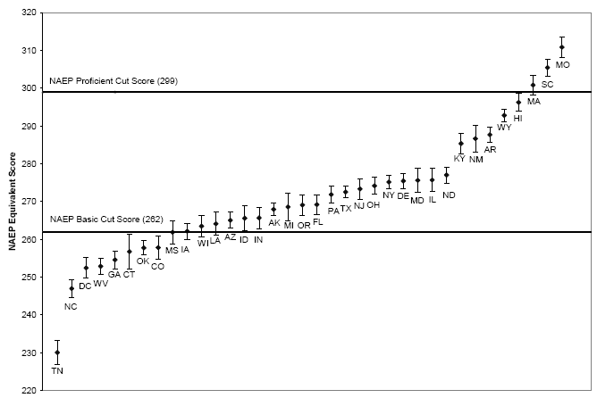
NAEP Score Equivalents of States’ Proficiency Standards, Grade 8 Math, 2005
Source: NCES, Mapping 2005 State Proficiency Standards Onto the NAEP Scales, http://nces.ed.gov

Slide 157
46 states and DC have adopted Common Core
But implementation has been slow, and the big shockers—first-time results—are yet to come.

Slide 158
Folks outside of education—especially employers--can help by explaining why new standards are so important.
By pressing for systematic and careful implementation. And by helping public to interpret what look like “lower” results..

Slide 159
In a recent analysis of the assignments middle school students get from their teachers, we found great variation in the level of challenge, with poor students getting less than others…but no schools very strong.

Slide 160
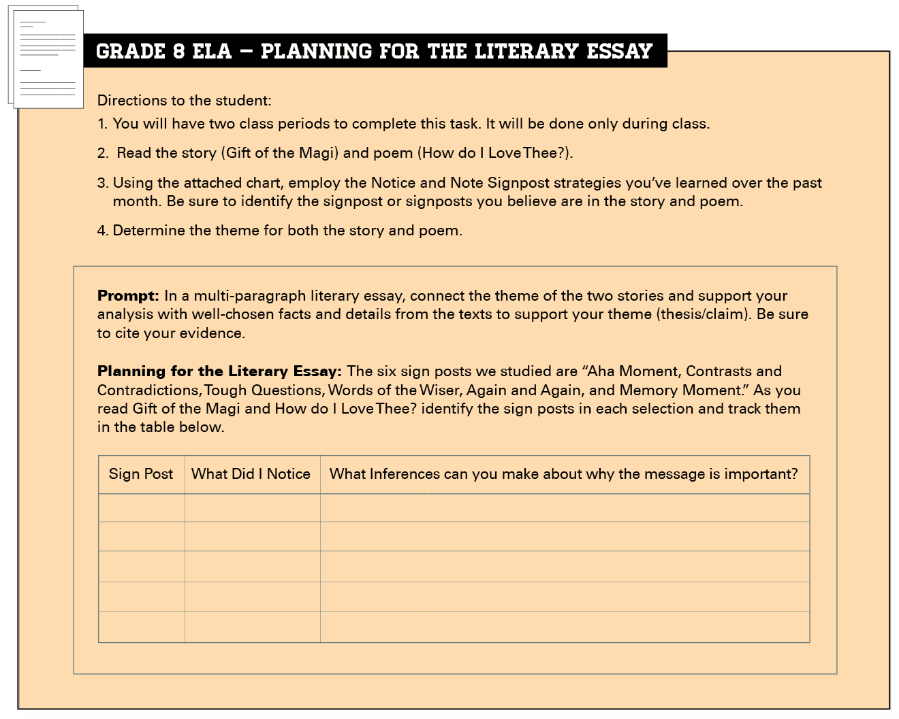
GRADE 7– English Language Arts
How can we make out voices heard? After reading I am Malala, write a literary essay in which you answer this question. Select and analyze one of the following:
  Any key person from the text
  The setting
  A theme from the text
Support your argument with evidence from the text. In your piece, be sure to write at least 5 paragraphs and follow the structure of a literary analysis.
Notes:
Key Talking Points:
Assignment fell within the HIGH RANGE on the literacy framework (met 6-8 indicators).
This culminating writing assignment comes at the end of a four week unit during which students read and discussed the text I am Malala through the lens of making one’s voice heard.
Strengths:
The task aligns with the Common Core standards; students are expected to build and support a thesis by analyzing textual evidence. Additionally, they are prompted to acknowledge a counterclaim – a distinguishing expectation in the standards for seventh grade writers.
The directions are clear; students know what is expected from them.
The text is central is this assignment; select and analyze textual evidence to support their argument.
High cognitive push for students; they must plan and develop their essay by deciding what their thesis will be, how they will defend or justify it and how they will sequence their ideas across multiple, cohesive paragraphs.
The overarching question of how one makes their voice heard in the world today may resonate for seventh grade students. This question, coupled with a contemporary nonfiction text focused on girl of similar age faced with challenges and injustices may engage students; there is strong potential for students to see the relevancy in these topics and ideas.
Points to Consider:
Text and Task Complexity: The Lexile of the text is 830; which falls into the Grades 4-5 range. While it is a straightforward literary nonfiction text, the setting and culture described in it may be unfamiliar for many students who have grown up in the United States. Additionally, the task students are asked to do with this text is complex and aligns with grade level standards. Question to Consider: Is it appropriate to use a text with a lower Lexile score if the assignments demands cognitive challenge for students that is aligned with grade level standards?
Scaffolds: Within the assignment there are specific expectations laid out by the teacher. They are told to write at least five paragraphs and to follow the structure for a literary analysis (we can infer that this structure was taught to students prior to this assignment). Additionally, students are cued to include an introduction, reasons, analysis, and a conclusion. They are also prompted to use the text and any notes or graphic organizers they have completed over the past four weeks. Two self-checklists are also provided as part of the assignment. Question to Consider: Are the embedded scaffolds a help or a hindrance for seventh grade students?
Motivation and Engagement: There is limited choice in this assignment. Although all students are expected to base their essay on the text I am Malala, students are allowed to choose how they will frame their analysis (e.g. any key person, the setting, a theme). As mentioned above, there is potential relevancy in the question of making one’s voice heard – and the ideas in this text are indeed contemporary and are expressed through the words of a young person. Questions to Consider: Are there other ways that choice and relevancy could be incorporated into this assignment?

Slide 161
GRADE 7 - English Language Arts
Read the poem, then fill in the blanks to create your own poem to communicate your thoughts and feelings about unfinished business in your life.
The Song I couldn’t Finish
by Jeanne
The words I couldn’t say
The call I couldn’t make
The time I couldn’t spend with you
The walls I couldn’t break through
The breath I couldn’t take
The air I couldn’t release
The love I couldn’t feel
The person I couldn’t convince
The song I couldn’t finish
Notes:
Key Talking Points:
Assignment fell within the LOW RANGE on the literacy framework (met 0-2 indicators).
Students are assigned to read a simple poem and then are tasked to create their own poem which mirrors it
Scaffolding is present throughout this assignment
The “fill in the blank” cloze activity leaves little room for choice and fostering student autonomy; although students are able to make changes to the proscribed outline
While the topics and ideas of the poem may resonate for young adolescents, they represent standalone points – rather than linked to ELA content or complex texts
Strengths/Weaknesses:
Assignment is clear, but does not align with Grade 7 Common Core ELA standards for reading or writing
The text is simple; students are not required to cite evidence or justify their thinking
Poetry writing is presented in a lockstep, proscribed manner
Few opportunities for creation/choice; relevance is linked with low-level; simple materials and task
Questions to Consider:
How might students engage in poetry writing that both honors their unique perspectives and pushes for complex thinking?
How can assignments couple relevance and engagement with rigorous content, texts, and tasks?

Slide 162
GRADE 7 - English Language Arts (continued)
The words I couldn’t say
I couldn’t say ___________________________
The things I couldn’t change
I couldn’t ______________________________
The walls I couldn’t break through
I couldn’t find a way to __________________
The feelings I couldn’t feel
I couldn’t ______________________________
The help I couldn’t give
I couldn’t ______________________________
The song I couldn’t finish
The song was about ____________________

Slide 163
Ed Trust Assignment Study:
What We Found
Fewer than 4 in 10 middle grades assignments are targeted at a grade-appropriate standard;
In high poverty schools the proportion drops to only about one third, compared to nearly half of assignments in low poverty schools;
That said, only about 5% of assignments in both kinds of schools tapped into the higher-level cognitive demands of the CCSS;
Most efforts at engagement and relevance were superficial, and often condescending.
Notes:
Text from current PPT presentation

Slide 164
Fourth, people matter: help keep momentum in the teacher effectiveness movement.

Slide 165
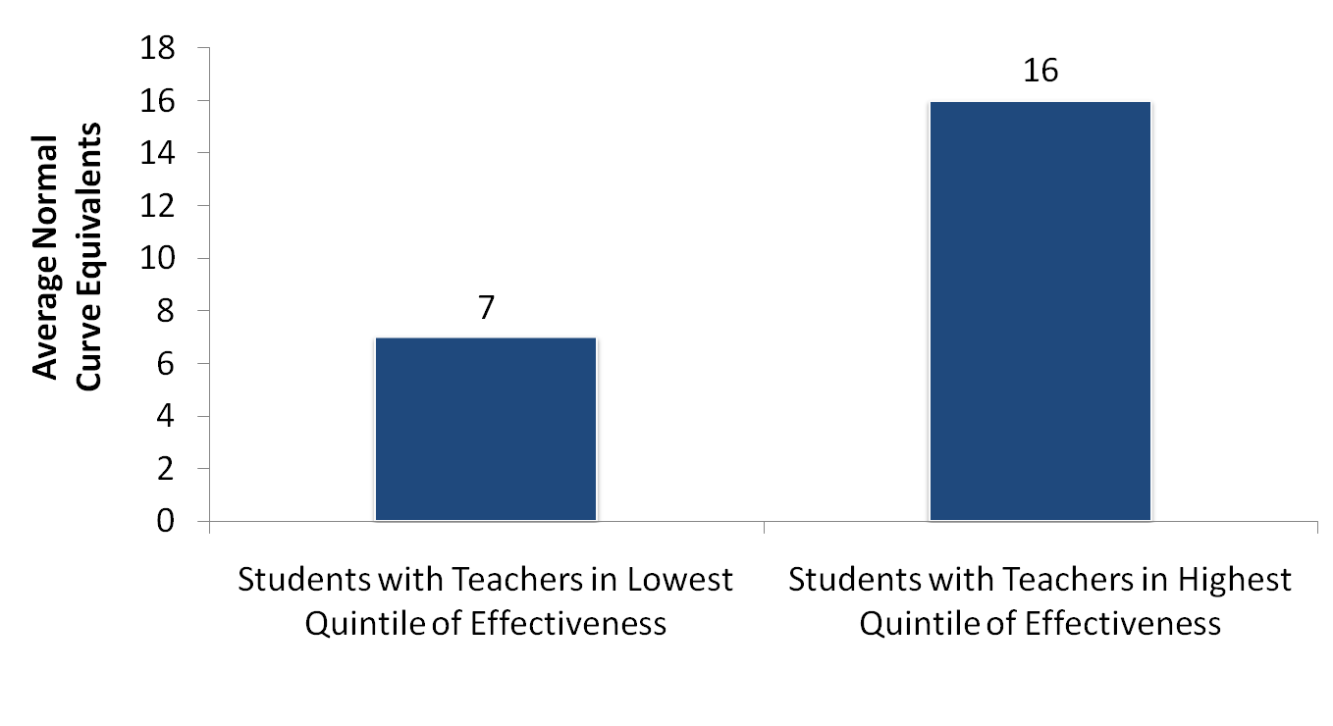
Students in Dallas Gain More in Math with Effective Teachers: One Year Growth From 3rd-4th Grade
Source: Heather Jordan, Robert Mendro, and Dash Weerasinghe, The Effects of Teachers on Longitudinal Student Achievement, 1997.

Slide 166
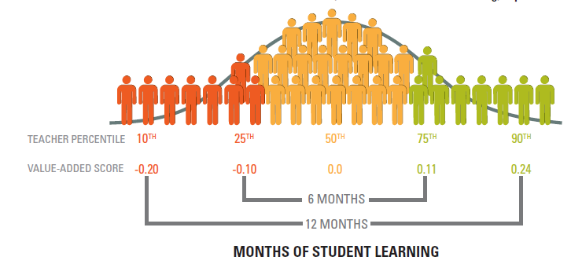
DIFFERENCES IN TEACHER EFFECTIVENESS ACCOUNT FOR LARGE DIFFERENCES IN STUDENT LEARNING
The distribution of value-added
scores for ELA teachers in LAUSD

Slide 167
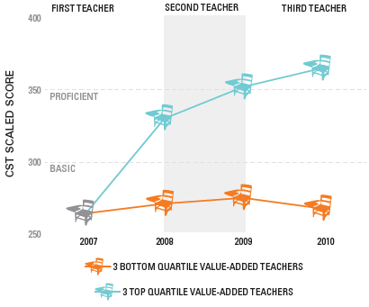
ACCESS TO MULTIPLE EFFECTIVE TEACHERS CAN DRAMATICALLY AFFECT STUDENT LEARNING
CST math proficiency trends for second-graders at ‘Below Basic’ or ‘Far Below Basic’ in 2007 who subsequently had three consecutive high or low value-added teachers

Slide 168
So, there are VERY BIG differences among our teachers.

Slide 169
BUT…
We pretend that there aren’t.

Slide 170
Make sure your state and districts are acting on this knowledge by:
Putting into place an honest evaluation system, that takes student growth into account;
Training principals and expert teachers in evaluation and feedback techniques;
Providing support to teachers who are struggling;
Working hard to hold onto the strongest ones, and chasing out the weak ones; and,
Assuring that all groups of children get their fair share of strong teachers.

Slide 171
PS: On all these matters, trust…but verify.

Slide 172
Fifth, principals matter hugely. States and districts need clear plan to grow new leaders.

Slide 173
This is way too important to be left to higher education.
And this is something that business can help with.

Slide 174
Finally, mind the gaps in opportunity and achievement.

Slide 175
True, gaps in achievement begin before children arrive at the schoolhouse door.
But, rather than organizing our educational system to ameliorate this problem, we organize it to exacerbate the problem.

Slide 176
Those practices aren’t good for kids. They are not good for our country. And they are not good for business.

Slide 177
We are taking the diversity that should be our competitive advantage in the international marketplace, and obliterating it.
Don’t just stand by and watch, even if they are not “your” kids. Speak up. Demand the data. Demand progress.

Slide 178
Download this presentation on our website
www.edtrust.org
Washington, D.C. Metro Detroit, MI
202/293-1217 734/619-8009
Oakland, CA New York, NY
510/465-6444

