Slide 1

Achievement and Opportunity in America:
Where are we? What more can we do?
University of Texas Arlington
5 April 2016
Arlington, TX

Slide 2
America: Two Powerful Stories

Slide 3
1. Land of Opportunity:
Work hard, and you can become anything you want to be.

Slide 4
2. Generational Advancement:
Through hard work, each generation of parents can assure a better life — and better education — for their children.

Slide 5
These stories animated hopes and dreams of people here at home
And drew countless immigrants to our shores

Slide 6
Yes, America was often intolerant…
And they knew the “Dream” was a work in progress.

Slide 7
We were:
The first to provide universal high school;
The first to build public universities;
The first to build community colleges;
The first to broaden access to college, through GI Bill, Pell Grants, …

Slide 8



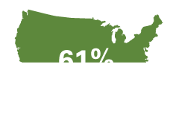
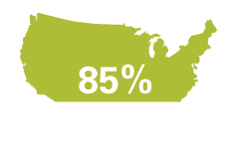
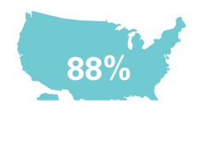
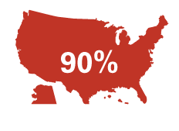
Percent of U.S. adults with a high school diploma
1920
1940
1960
1980
2000
2012

Slide 9

Percent of U.S. adults with a B.A. or more
1920
1940
1960
1980
2000
2012
11%
23%
29%
6%
4%
33%

Slide 10
Progress was painfully slow, especially for people of color. But year by year, decade by decade…

Slide 11
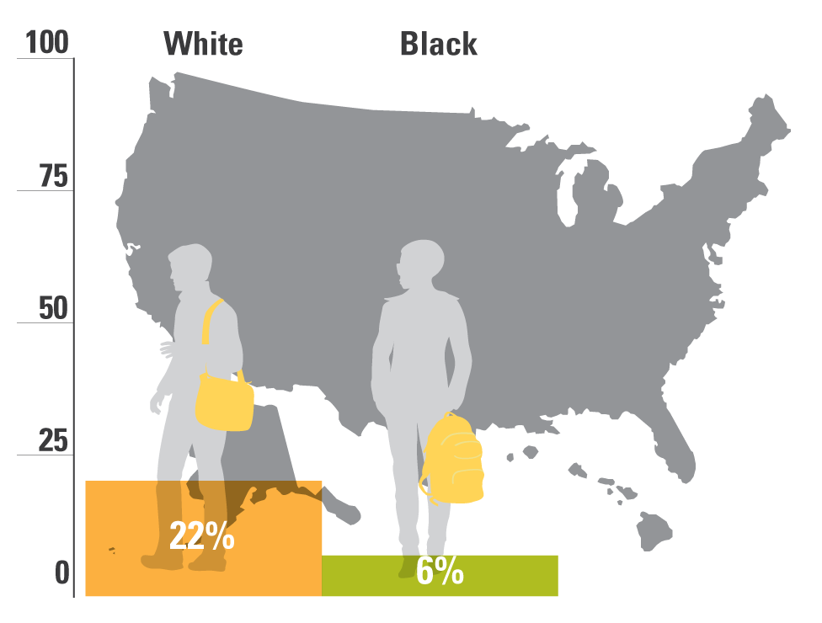
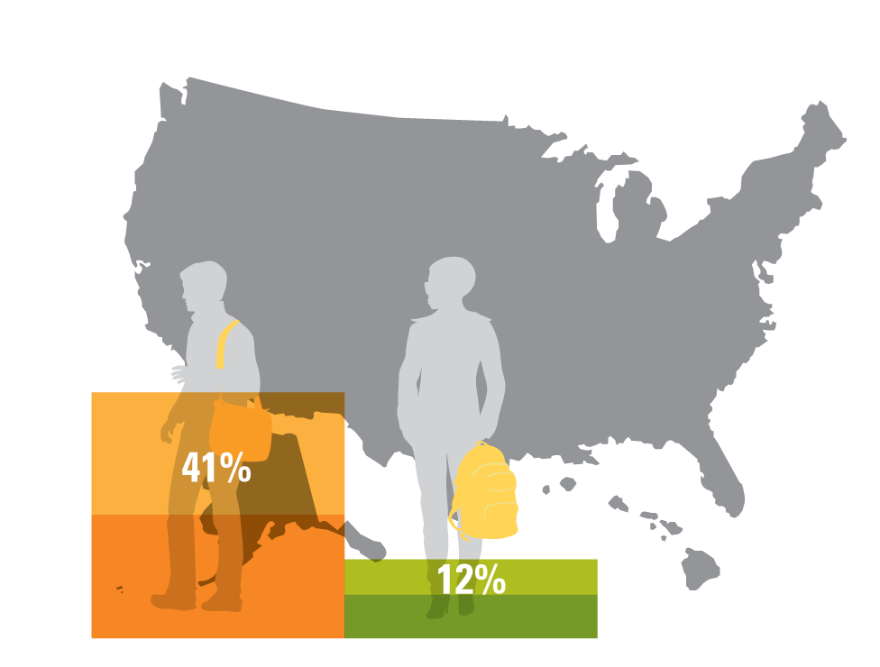
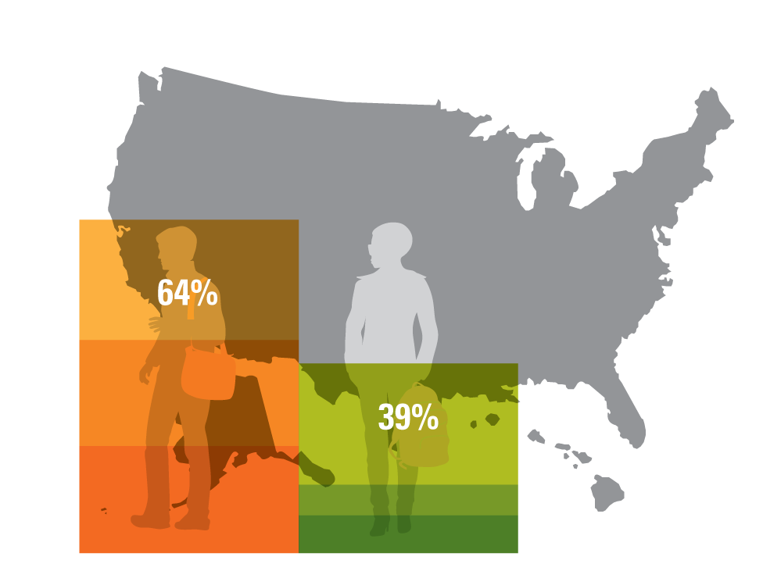
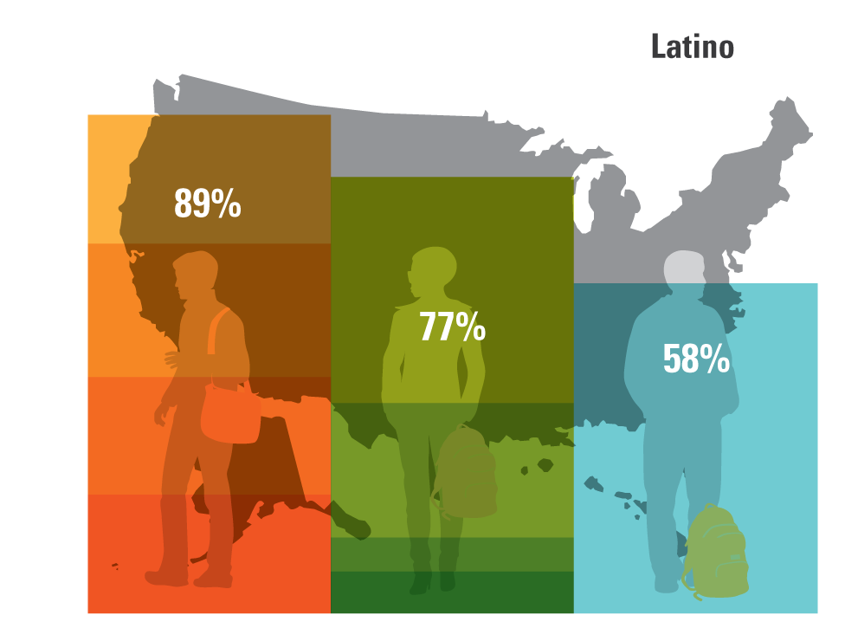
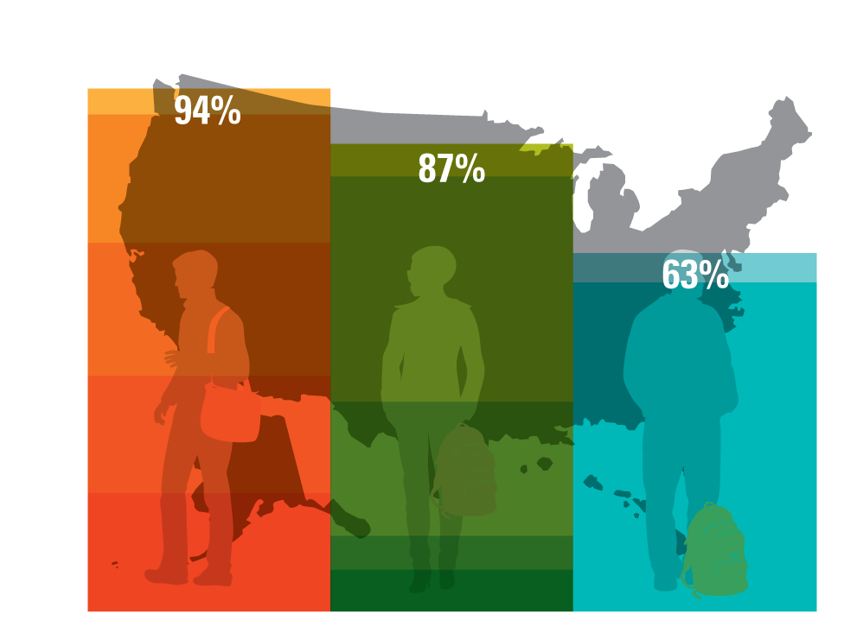
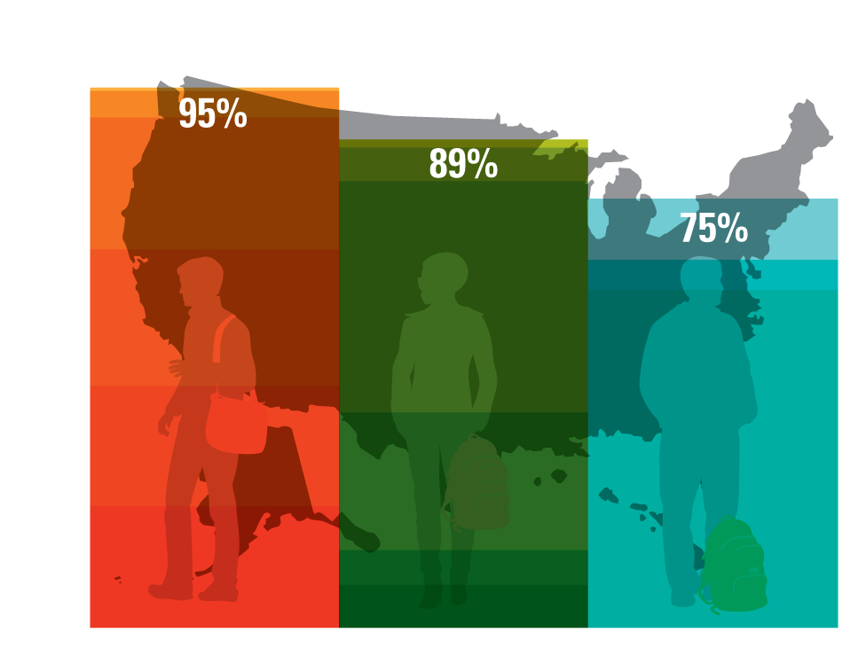
Percent of U.S. adults with a high school diploma, by race
1940
1920
1960
1980
2000
2012

Slide 12
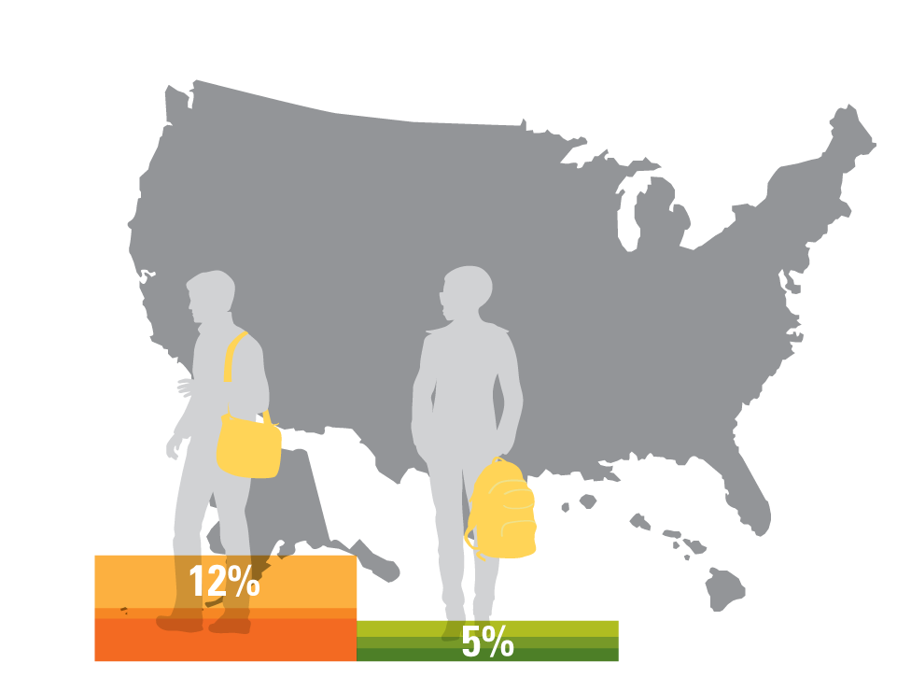
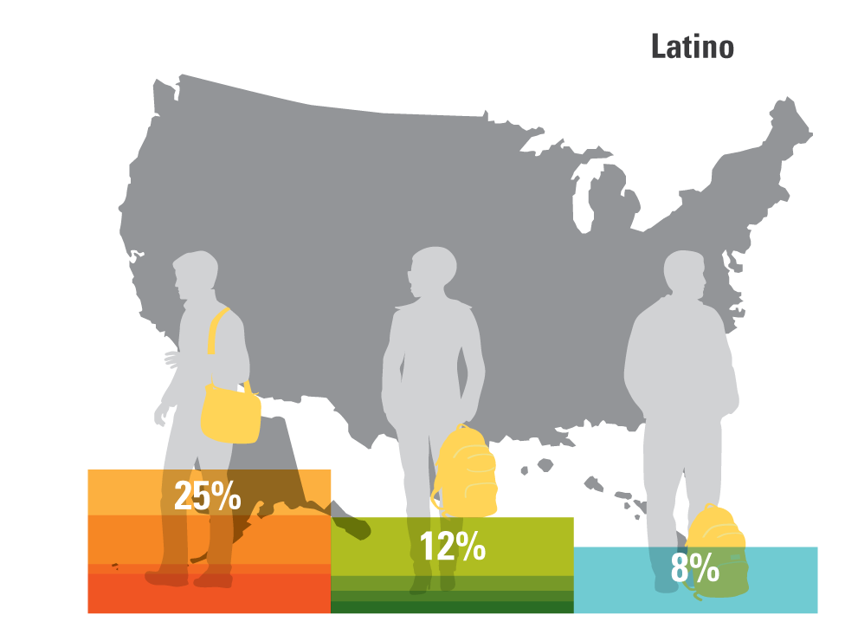
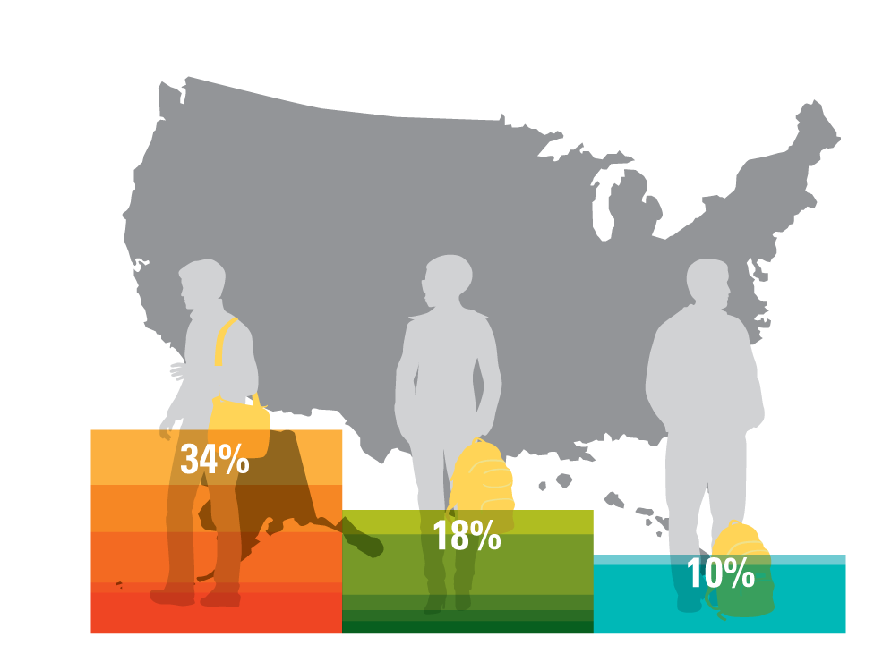
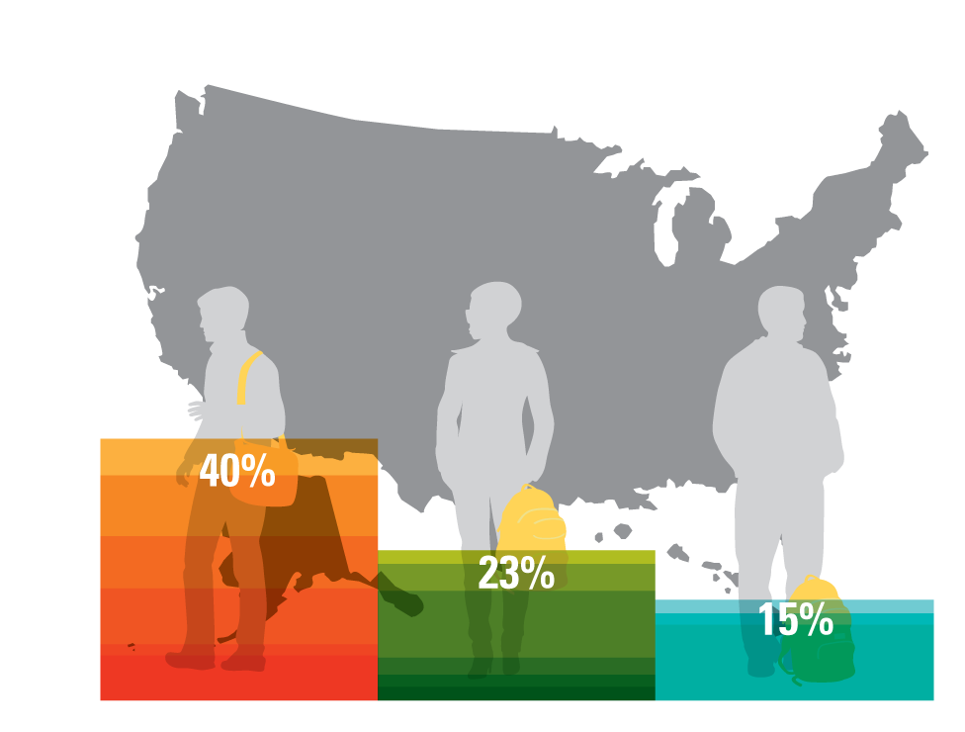
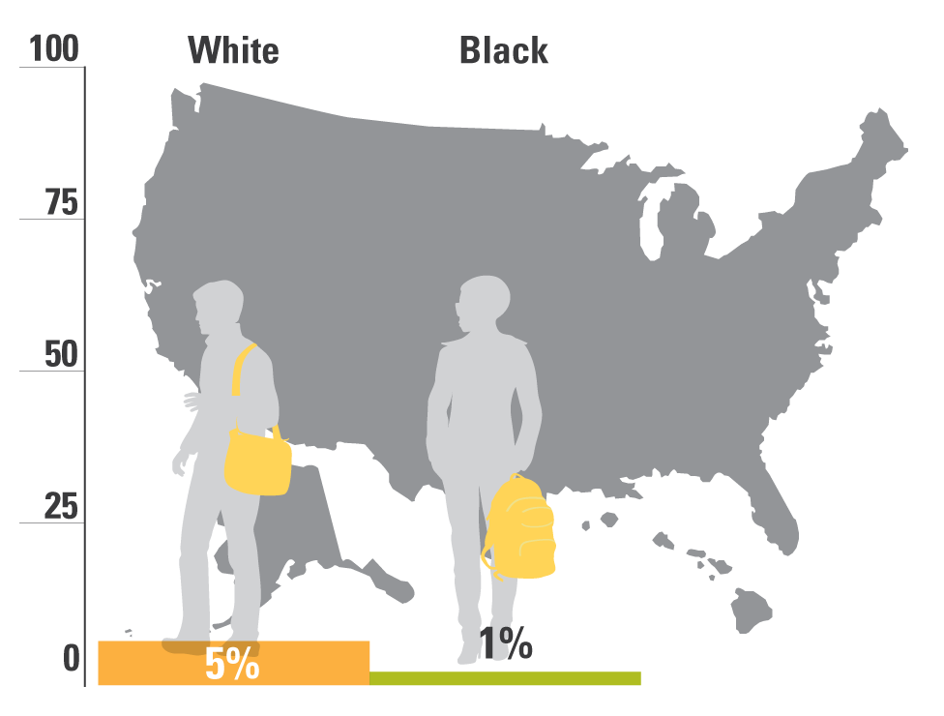

Percent of U.S. adults with a B.A. or more, by race
1960
1980
2000
2012
1920
1940

Slide 13
Then, beginning in the eighties, growing economic inequality started eating away at our progress.

Slide 14
In recent years, most income gains have gone to those at the top of the ladder, while those at the bottom have fallen backwards.
Source: Stiglitz, “Inequality is a Choice,” New York Times, October 13, 2013.

Slide 15
Wealthiest US households take greater share of income, while poorest 20% fall backwards
Source: U.S. Census Bureau, Current Population Survey Annual Social and Economic Supplements, Table H-2. Share of Aggregate Income Received by Each Fifth and Top 5 Percent of Households, All Races: 1967 to 2014.
Notes:
Updated 12/3/15 DEB
https://www.census.gov/hhes/www/income/data/historical/household/?cssp=SERP
Checked 1/8/14 JY
Updated 10/29/13 MW
http://www.census.gov/hhes/www/income/data/historical/household/

Slide 16
Instead of being the most equal, the U.S. has the third highest income inequality among OECD nations.
United States
Note: Gini coefficient ranges from 0 to 1, where 0 indicates total income equality and 1 indicates total income inequality
Source: United Nations, UN Data 2013, http://data.un.org/DocumentData.aspx?q=income+inequality&id=365
Notes:
Updated 12/3/15 DEB
Checked 1/8/14 JY
Updated 10/29/13 MW
http://data.un.org/DocumentData.aspx?q=income+inequality&id=328

Slide 17
Inequality particularly pronounced for Black and Latino families…

Slide 18
Blacks and Latino families have lower earnings…
The College Board, “Trends in College Pricing 2015” (New York: College Board, 2015), Figure 22B.
Notes:
Updated 12/3/15 DEB
Updated 10/29/13 MW
http://trends.collegeboard.org/college-pricing

Slide 19
…And less than one-tenth of the household wealth.
Pew Research Center tabulations of Survey of Consumer Finances public-use data.
Notes:
Updated 12/3/15 DEB http://www.pewresearch.org/fact-tank/2014/12/12/racial-wealth-gaps-great-recession/
Updated 11/19/13 MW
With data from 2005; Have data going back to 1984, but see below for notes from report:
“Notes: Blacks and whites include Hispanics. The Survey of Income and Program Participation was redesigned for the 1996 panel. The redesign may have affected the comparability of the data from 1998 and later years with the data from earlier panels”
http://www.pewsocialtrends.org/files/2011/07/SDT-Wealth-Report_7-26-11_FINAL.pdf

Slide 20
Not just inequality in wages and wealth, but growing problems with social mobility, as well.

Slide 21
U.S. intergenerational mobility was improving until 1980, but barriers have gotten higher since.
Source: Daniel Aaronson and Bhashkar Mazumder. Intergenerational Economic Mobility in the U.S.,1940 to 2000. Federal Reserve Bank of Chicago WP 2005-12: Dec. 2005.
Notes:
From the Aaronson and Mazumder report: “In particular, mobility increased from 1940 to 1980, but fell sharply during the 1980s and failed to revert, perhaps even continued to decline, in the 1990s.”
From the Aaronson and Mazumder report, the figure for 2000 (0.58) is not statistically significant. The figure for 1990 (0.46) almost mirrors the number cited for the US in the cross-country analysis on the next slide.

Slide 22
The US now has one of lowest rates of intergenerational mobility
Source: Corak, Miles. Chasing the Same Dream, Climbing Different Ladders. Economic Mobility Project; Pew Charitable Trusts, 2010.
Notes:
Checked 1/8/14 JY
Updated 11/14/13 MW

Slide 23
At macro level, better and more equal education is not the only answer.
But at the individual level, it really is.

Slide 24
College Grads Earn More
$102,200
$91,000
$70,000
$56,500
$40,400
$44,800
$35,400
$25,100
Source: College Board, Education Pays, 2013, Figure 1.1: Median Earnings and Tax Payments of Full-Time Year-Round Workers Ages 25 and Older, by Education Level, 2011

Slide 25
College Grads Less Likely to be Unemployed
Source: U.S. Bureau of Labor Statistics, Table A-4, http://www.bls.gov/news.release/empsit.t04htm

Slide 26
They also stand out on the other things we value.

Slide 27
College graduates more likely to vote
Note: Data include both those who are and are not registered to vote.
Source: Education Pays 2013, The College Board

Slide 28
College graduates more likely to volunteer
Note: Data represent percentage of total population that reported volunteering from September 2008 to September 2009
Source: Education Pays 2013, The College Board

Slide 29
College Grads of all races far more likely to be in “Very Good” or “Excellent” Health
Robert Wood Johnson Foundation Commission for a Healthier America, 2009

Slide 30
College Grads Even Have Better Mental Health
Source: Gallup, “Strong Relationship Between Income and Mental Health” (2007)

Slide 31
What schools and colleges do, in other words, is hugely important to our economy, our democracy, and our society.

Slide 32

So, how are we doing?

Slide 33
Over past 30 years, we’ve made a lot of progress on the access side.
n/a

Slide 34
Immediate College-Going Up
Note: Percent of high school completers who were enrolled in 2-year or 4-year college the October after completing high school
Source: NCES, The Digest of Education Statistics 2013 (Table 302.10).
Notes:
MNB confirmed, 1/8/14
Updated 11/20/13 MW
http://nces.ed.gov/programs/digest/d13/tables/dt13_302.10.asp
5/23/13 Note: The Digest of Education Statistics only has data going up to 2011. It did not match the 2011 BLS data. To stay consistent, we will use Digest 2012 (it was referenced by the Condition 2013). Mary will check with someone at NCES to see why the Digest 2012 numbers don’t match the 2011 BLS data, and the timing mismatch (why does BLS have 2012 data already?).
5/8/13 Note: Mary included 2011 and 2012 data directly from the BLS October supplement (http://www.bls.gov/news.release/archives/hsgec_04192012.pdf and http://www.bls.gov/news.release/pdf/hsgec.pdf) to the CPS for college enrollment. The Condition of Education 2013 is not yet released (should be May 2013 based on the Condition 2012), so be sure to re-check when the 2013 Condition is released.
Can we use Condition of Ed 2011 here instead of the Digest, so that we’re consistent with the next 2 slides, which break down college-going rates by race and income?

Slide 35
College-going is up for all groups.
NCES, The Condition of Education 2010 (Table A-20-3) and The Condition of Education 2011 (Table A-21-2).

Slide 36
Immediate College-Going Increasing for All Racial/Ethnic Groups: 1972 to 2012
Note: Percent of high school completers who were enrolled in college the October after completing high school
Source: NCES, The Digest of Education Statistics 2013 (Table 302.20).
Notes:
Checked 1/8/14 JY
Updated 11/20/13 MW
http://nces.ed.gov/programs/digest/d13/tables/dt13_302.20.asp
5/23/13: Mary used 2012 Digest numbers for 2011 stats. Previous BLS stats for 2011 and 2012 did not match/Digest only goes up to 2011. Will email NCES to confirm.
5/10/13 Note: Should we reconsider making this chart with moving averages, rather than annual changes if we’re concerned about unstable sample sizes?
5/8/13 Note: Mary included 2011 and 2012 data directly from the BLS October supplement (http://www.bls.gov/news.release/archives/hsgec_04192012.pdf and http://www.bls.gov/news.release/pdf/hsgec.pdf) to the CPS for college enrollment. The Condition of Education 2013 is not yet released (should be May 2013 based on the Condition 2012), so be sure to re-check when the 2013 Condition is released.
Adjust formatting to match other line graphs.
Change colors to match Ed Trust color guide.

Slide 37
College-Going Generally Increasing for All Income Groups
Note: Percent of high school completers who were enrolled in college the October after completing high school
Source: NCES, The Condition of Education 2010 (Table A-20-1) and The Digest of Education Statistics 2013 (Table 302.30).
Notes:
Checked 1/8/14 JY
Updated 11/20/13 MW
http://nces.ed.gov/programs/digest/d13/tables/dt13_302.30.asp
5/23/13 Note: The 2013 Condition does not provide Appendix tables as it used to with previous Conditions. It instead referred to the 2012 Digest of Education Statistics for tables (it cited the Table #, so should be okay). The 2012 Digest gives data from 1975-2011 (it was released in May 2013).
5/8/13 Note: It does not look like the 2011 and 2012 BLS Oct. supplements looked at income status, will need to revisit with 2013 Condition.
Check colors against Ed Trust color guide

Slide 38
But though college going up for low-income students…

Slide 39
Low-Income Students Today Still Not Reaching the College-going Rate for High-Income Students in 1972…
Note: Data for black, Hispanic, and low-income represent two-year moving average because of small sample sizes.
Source: NCES, The Condition of Education 2010 (Table A-20-1) and The Digest of Education Statistics 2013 (Table 302.30)
Notes:
MNB checked 1/8/14
http://nces.ed.gov/programs/digest/d13/tables/dt13_302.30.asp
Updated 1/2/14 MW
(Advanced release of Digest 2013 selected tables)
5/23/13 Note: Mary updated race and income numbers acc. to Digest 2012. BLS 2011/2012 race numbers didn’t match; Digest gives low-income numbers only up to 2011.
Years: 1972-73 (Condition 2010); 2010-2011 (Digest 2012)
Note to Mary: Always use the 3-year moving average data from the most recent Condition/Digest of Education (2-year average for endpoints)
5/8/13 Note: It does not look like the 2011 and 2012 BLS Oct. supplements looked at income status, will need to revisit with 2013 Condition.

Slide 40
But access isn’t the only issue:
There’s a question of access to what…

Slide 41
Low-Income Students and Students of Color Twice as Likely to Enter For-profit Colleges
Ed Trust analysis of IPEDS Fall enrollment, Fall 2012 (by race) and IPEDS Student Financial Aid survey, 2011-12 (by Pell recipient status).
Notes:
MNB checked 1/8/14
Updated race percentages for 2012-13 1/2/14 MW (Fall 2012 enrollment)
Updated Pell percentages for 2011-12 11/19/13 MW (Fall 2011 enrollment)
Updated race percentages for 2012-13 1/2/14 MW
Updated Pell percentages for 2011-12 11/19/13 MW
MNB updated with most recent IPEDS data for fall URM enrollment distribution & Pell enrollment distribution across 9 sectors (2010-11 school year most recent for racial breakdown) 9/6/13

Slide 42

Access to what?
For-profit college companies
11% of enrollments
24% of Pell Grants and
federal student loan dollars
Lowest degree completion rates of
any 4-year sector
48% of federal student
loan defaults
IPEDS Enrollment Fall 2011 First Look (December 2012); Majority staff calculation of data provided by U.S. Department of Education, 2008-09 in “Emerging Risk?: An Overview of Growth, Spending, Student Debt and Unanswered Questions in For-Profit Higher Education.” Senate HELP Committee. 24 June 2010 (page 4); and Ed Trust analysis of FY 2009 data in “Institutional Default Rate Comparison of FY 2007, 2008, and 2009 Cohort Default Rates.” http://www.gao.gov/new.items/d114.pdf (page 8)
Notes:
Updated 8/27/13 – Mary updated % enrollment (was 13%, now 11% as of Fall 2011)

Slide 43
And what about graduation in colleges more generally?

Slide 44
Black, Latino, and American Indian Freshmen Complete College at Lower Rates Than Other Students
6 -year bachelor’s completion rates for first-time, full-time freshmen,
Fall 2008 cohort at 4-year institutions
Source: NCES (December 2015). Graduation Rates for Selected Cohorts, 2006-11; Student Financial Aid, Academic Year 2013-14; and Admissions in Postsecondary Institutions, Fall 2014. First Look (Provisional Data)
Notes:
Updated 1/15/16 DEB
MNB checked 1/8/14
Updated 1/2/14 MW

Slide 45
Graduation rates at
public community colleges
Source: NCES (Dec. 2013). First Look: Enrollment in Postsecondary Institutions, Fall 2012; Financial Statistics, Fiscal Year 2012; and Graduation Rates, Selected Cohorts, 2004-2009, First Look (Provisional Data) Table 3.
Notes:
MNB checked 1/8/14
Updated 1/2/14 MW

Slide 46
Chance of attaining a bachelor’s degree within six years, among students who aspire to a Bachelors degree and begin at community college?
n/a

Slide 47
Only 14 percent.
Percent of students who started at a community college intending to earn a Bachelor’s in 2003 and
earned a BA degree by 2009
Source: U.S. Department of Education, National Center for Education Statistics, 2003-04 Beginning Postsecondary Students Longitudinal Study, First Follow-up (BPS:04/06).

Slide 48
Add it all up…

Slide 49
Different groups of young Americans obtain degrees at very different rates.
n/a

Slide 50
Whites attain bachelor’s degrees at nearly twice the rate of blacks and almost three times the rate of Hispanics
Source: U.S. Census Bureau, Educational Attainment in the United States: 2014
Notes:
Updated 1/15/16 DEB
Updated 1/28/14 MW with 2013 data
MNB confirmed 1/7/2014

Slide 51
Young adults from high-income families are 3 times as likely as those from low-income families to earn bachelor’s degrees by age 24
http://www.brookings.edu/research/papers/2015/03/12-chalkboard-income-education-attainment-chingos
Notes:
DEB updated 2/29/16
MNB confirmed 1/7/14
Possible update - Subscription to Postsecondary Education Opportunity?

Slide 52
These rates threaten health of our democracy.
But even for those who don’t care much about that, they are particularly worrisome, given which groups are growing…and which aren’t.

Slide 53
Changing demographics demand greater focus on underrepresented populations.
Population Increase, Ages 0-24, (in thousands)
Percentage Increase, Ages 0-24,
Note: Projected Population Growth, Ages 0-24, 2010-2050
Source: National Population Projections, U.S. Census Bureau. Released 2008; NCHEMS ,Adding It Up, 2007

Slide 54
Not surprisingly, our international lead is slipping away

Slide 55
We’re relatively strong in educational attainment
United States
OECD Average
Organisation for Economic Co-operation and Development, Education at a Glance 2015 (2014 data).
Notes:
Note: Adults with a postsecondary degree include those who have completed either a tertiary-type B program (programs that last for at least two years, are skill-based, and prepare students for direct entry into the labor market) or a tertiary-type A program (programs that last at least three, but usually four, years, are largely theory-based, and provide qualifications for entry into highly-skilled professions or advanced research programs)
Updated 12/14/15 DEB
Checked 1/8/14 JY
Updated 10/23/13 MW

Slide 56
Our world standing drops to 11th for younger adults
United States
OECD Average
Organisation for Economic Co-operation and Development, Education at a Glance 2015 (2014 data).
Notes:
Note: Adults with a postsecondary degree include those who have completed either a tertiary-type B program (programs that last for at least two years, are skill-based, and prepare students for direct entry into the labor market) or a tertiary-type A program (programs that last at least three, but usually four, years, are largely theory-based, and provide qualifications for entry into highly-skilled professions or advanced research programs)
Updated 12/9/15 DEB
Checked 1/8/14 JY
Updated 10/21/13 Mary

Slide 57
Young Americans today are only slightly more likely than older Americans to earn a college degree, far trailing advances in other countries
OECD Average
United States
Organisation for Economic Co-operation and Development, Education at a Glance 2015 (2014 data).
Notes:
Note: Adults with a postsecondary degree include those who have completed either a tertiary-type B program (programs that last for at least two years, are skill-based, and prepare students for direct entry into the labor market) or a tertiary-type A program (programs that last at least three, but usually four, years, are largely theory-based, and provide qualifications for entry into highly-skilled professions or advanced research programs)
Updated 12/9/15 DEB
Checked 1/8/14 JY
Not updated for 2013 report. Data not available. 10/29/13 MW

Slide 58
WHAT’S GOING ON?
Many in higher education would like to believe that these patterns are mostly a function of lousy high schools and stingy federal and state policymakers.

Slide 59
They are not all wrong.

Slide 60


Slide 61
Low Income and Minority Students Continue to be Clustered in Schools where we spend less…

Slide 62
National Inequities in State and Local Revenue Per Student
 | Gap
High Poverty vs. Low Poverty Districts | –$1200 per student
High Minority vs. Low Minority Districts | –$2,000 per student
Education Trust analyses based on U.S. Dept of Education and U.S. Census Bureau data for 2010-12

Slide 63
…expect less

Slide 64
Students in Poor Schools Receive ‘A’s for Work That Would Earn ‘Cs’ in Affluent Schools
Prospects (ABT Associates, 1993), in “Prospects: Final Report on Student Outcomes”, PES, DOE, 1997

Slide 65
…teach them less

Slide 66
Even African-American students with high math performance in fifth grade are unlikely to be placed in algebra in eighth grade
Source: NCES, “Eighth-Grade Algebra: Findings from the Eighth-Grade Round of the Early Childhood Longitudinal Study, Kindergarten Class of 1998-99 (ECLS-K)” (2010).

Slide 67
…and assign them our least qualified teachers.

Slide 68
Students at high-minority schools are more likely to be taught by novice teachers
Note: Novice teachers are those with three years or fewer experience.
High-minority ≥ 75% students non-white. Low-minority ≤ 10% students non-white.
Analysis of 2003-2004 Schools and Staffing Survey data by Richard Ingersoll, University of Pennsylvania (2007)
Notes:
Data are from the 2003-2004 Schools & Staffing Survey (SASS)
SASS surveys a nationally representative sample of teachers.
Analysis examines out-of-field teaching in core academic classes at secondary and middle school:
Core academic classes are English, math, social studies, and science.
“Out-of-field” is defined as a teacher lacking both an in-field regular certification and a major in the subject of the classes he or she was assigned to teach.
Secondary classes include departmentalized classes in grades 7-12.
Middle grades include 5-8. Only teachers assigned to departmentalized classes count toward middle grades.

Slide 69
Core classes in high-poverty and high-minority secondary schools are more likely to be taught by out-of-field teachers
High Poverty
Low Poverty
High Minority
Low Minority
Note: Data are for secondary-level core academic classes (Math, Science, Social Studies, English) across United States.
High-poverty ≥75% of students eligible for free/reduced-price lunch. Low-poverty school ≤15% of students eligible.
High-minority ≥ 75% students non-white. Low-minority ≤ 10% students non-white.
The Education Trust, Core Problems: Out-of-Field Teaching Persists in Key Academic Courses and High-Poverty Schools, (2008)

Slide 70
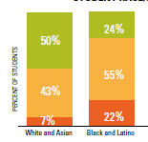
Los Angeles: Black, Latino students have fewer highly effective teachers, more weak ones.
READING/LANGUAGE ARTS
Latino and black students are:
3X as likely to get low- effectiveness teachers
½ as likely to get highly effective teachers
Source: Education Trust—West, Learning Denied, 2012.

Slide 71
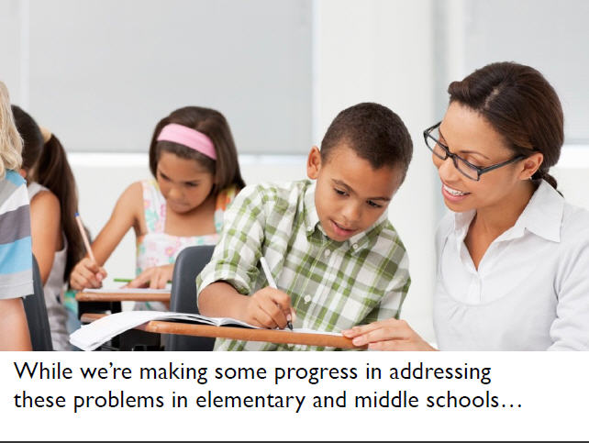

Slide 72
Since 1999, large gains for all groups of students, especially students of color
*Denotes previous assessment format
National Center for Education Statistics, “The Nation's Report Card: Trends in Academic Progress 2012”

Slide 73
Since 1999, performance rising for all groups of students
*Denotes previous assessment format
National Center for Education Statistics, “The Nation's Report Card: Trends in Academic Progress 2012”

Slide 74
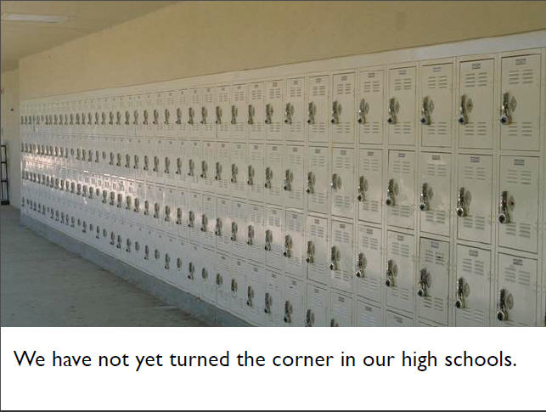

Slide 75
Reading: Not much gap narrowing since 1988.
*Denotes previous assessment format
National Center for Education Statistics, “The Nation's Report Card: Trends in Academic Progress 2012”

Slide 76
Math: Not much gap closing since 1990.
*Denotes previous assessment format
National Center for Education Statistics, “The Nation's Report Card: Trends in Academic Progress 2012”

Slide 77
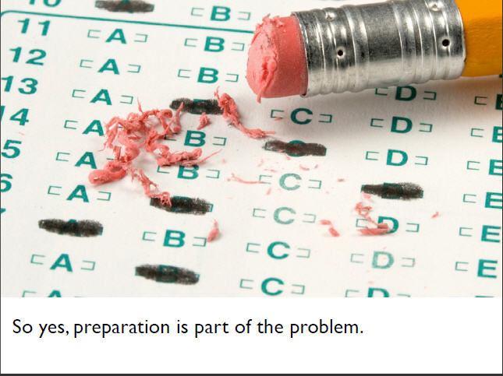

Slide 78

So, too, are misguided government aid policies

Slide 79
College costs have increased at 4.5 times the rate of inflation
Source: Bureau of Labor Statistics, Annual Average CPI Index, 2011: http://www.bls.gov/cpi/cpid11av.pdf; Census Bureau, Income, Poverty, and Health Insurance Coverage in the United States: 2012; Table F-6.
Notes:
MNB checked 1/8/14
Updated 10/29/13 JY

Slide 80
Federal Pell Grants have failed to keep pace with rising college costs
Total Cost of Attendance Covered by
Maximum Pell Grant Award
American Council on Education (2007). “ Status Report on the Pell Grant Program, 2007” and College Board, Trends in Student Aid, 2013.
Notes:
Updated 5/18/14 MW
2007 most recent report from ACE 11/19/13 MW

Slide 81
Why? Not because we’re not spending a lot more on student aid.
But, rather, because we’ve changed who gets those dollars.

Slide 82
In FY13, $21 billion federal dollars were diverted in to education tax benefits, many of which benefit institutions or wealthier students.
Source: Fiscal Year 2014 Analytical Perspectives, Budget of the U.S. Government, Office of Management and Budget, Table 16-1. Estimates of Total Income Tax Expenditures for Fiscal Years 2012-2018.
Notes:
MNB updated FY13 1/8/14
http://www.whitehouse.gov/sites/default/files/omb/budget/fy2014/assets/spec.pdf
Updated 11/20/13 MW, FY12 correct – MNB checked 1/8/14, but FY13 now available.
Includes: Hope Tax Credit, AOTC, Lifetime Learning Credit, Deductibility of student-loan interest, Parental personal exemption for students age 19 or over

Slide 83
51% of savings from tuition tax credits go to middle- and upper-income families
Source: The College Board, Trends in Student Aid 2013.
Notes:
Checked 1/8/14 JY

Slide 84
88% of savings from tuition tax deductions go to middle- and upper-income families
Note: Percentages may not add to 100% because of rounding.
Source: The College Board, Trends in Student Aid 2013.
Notes:
Checked 1/8/14 JY

Slide 85
Pattern is the same at state level, even in tough times.
Source: Trends in Student Aid 2010, The College Board

Slide 86
Non-need-based grant aid now represents more than a quarter of all state grant aid
Source: The College Board, Trends in Student Aid 2013.
Notes:
Checked 1/8/14 JY
Updated 12/17/13 MW

Slide 87
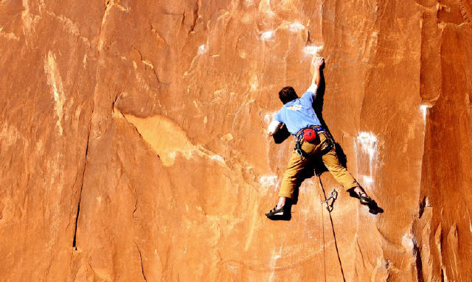
Big Effects, too, from State Disinvestment in Public Higher Education.

Slide 88
We start out by spending less per student in the institutions serving students with the biggest needs. Then, over the past few years, we just cut mercilessly from there.

Slide 89
So yes, government policy is part of the problem, too.

Slide 90
But colleges and universities are not unimportant actors in this drama of shrinking opportunity, either.

Slide 91
For one thing, the shifts away from poor students in institutional aid money are MORE PRONOUNCED than the shifts in government aid.

Slide 92
In 2011, four-year public and
private nonprofit colleges
spent over $21 billion on grant aid.
Education Trust analysis of NPSAS:12 using PowerStats. Results based on full-time, full-year, one-institution dependent undergraduates.
Notes:
Updated 11/19/13 MW, confirmed 1/6/13 MNB
Note: Used average institutional grant total excluding zeros for both public and private non-profit colleges and multiplied by weighted sample sizes. 2008 estimate did not match the 15 billion from the old slide (our result was 14 billion); Could be due to NPSAS changing the weights used.

Slide 93
But, they spent a lot of aid on students who didn’t need it…
Education Trust analysis of NPSAS:12 using PowerStats. Results based on full-time, full-year, one-institution dependent undergraduates.

Slide 94
Public 4-year colleges used to spend more than twice as much on needy students, but now spend more on wealthy students
Education Trust analysis of NPSAS:96, NPSAS:08, NPSAS:12 using PowerStats. Results based on full-time, full-year, one-institution dependent undergraduates.
Notes:
MNB re-ran estimates on 1/6/13 for all years. 1995 and 2007 estimates slightly different with revised NPSAS weights.
Previous data (before update):
1995 Institutional Grant Aid
Lowest Income quintile = $437
Highest Income quintile = $179
2007 Institutional Grant Aid
Lowest Income quintile = $744
Highest Income quintile = $695

Slide 95
Private nonprofit 4-year colleges used to spend more on low-income students, but now spend nearly twice as much on wealthy students
Education Trust analysis of NPSAS:96, NPSAS:08, NPSAS:12 using PowerStats. Results based on full-time, full-year, one-institution dependent undergraduates.
Notes:
MNB re-ran estimates on 1/6/13 for all years. 1995 and 2007 estimates slightly different with revised NPSAS weights.
Previous data (before update):
1995 Institutional Grant Aid
Lowest Income quintile = $919
Highest Income quintile = $887
2007 Institutional Grant Aid
Lowest Income quintile = $1478
Highest Income quintile = $2673

Slide 96
Low-income students must devote an amount equivalent to 76% of their family income towards college costs
Family Income Percentile | Average Income | Average Cost of Attendance | Average Expected Family Contribution (EFC) | Average Grant Aid | Average Unmet Need After EFC and Grant Aid | Average % of Income Required to Pay Out-of-Pocket Expenses
21 – 40% | $36,205 | $29,345 | $2,138 | $12,246 | $15,006 | 46%
61 – 80% | $97,733 | $30,719 | $16,259 | $6,842 | $9,465 | 25%
0 – 20% | $12,783 | $27,428 |  | $13,565
$276
$13,591
76%
41 – 60% | $65,204 | $29,804 |  | $8,465
$8,059
$13,689
33%
81 – 100% | $185,819 | $34,370 |  | $6,041
$35,925
$5,281
17%
Source: Education Trust analysis of NPSAS:12 using PowerStats, http://nces.ed.gov/datalab/.
Results based on full-time, full-year, one-institution dependent undergraduates at public and private nonprofit four-year colleges
Notes:
*No animation
As expected, estimates for % of income to pay out-of-pocket expenses have increased slightly from 2008.
- Compared to 2008 numbers, average incomes dropped in the bottom 80% of incomes, while they rose for the top 20% (note income estimates are not inflation-adjusted)
Cost of attendance, meanwhile, has increased
EFC has decreased, average grant aid has increased but not enough to blunt decreased incomes/EFC and higher COA
Previous numbers from 2008:
0-20%: $17,042 income | $22,052 cost of attendance | $907 EFC | $9,828 average grant aid | $11,316 unmet need | 72% of income
21-40%: $42,567 income | $23,285 cost of attendance | $3,974 EFC | $7,832 average grant aid | $11,479 unmet need | 36% of income
41-60%: $67,808 income | $23,704 cost of attendance | $10,174 EFC | $5,415 average grant aid | $8,115 unmet need | 27% of income
61-80%: $97,542 income | $25,107 cost of attendance | $18,105 EFC | $4,590 average grant aid | $2,412 unmet need | 21% of income
81-100%: $$173,277 income| $27,690 cost of attendance | $37,699 EFC | $3,832 average grant aid | -$13,840 unmet need | 14% of income
Updated 12/9/13 MW, MNB cleaned 1/6/14
Update Notes: Remember to filter for public and private nonprofit 4-year colleges, and from now on, DO NOT add/subtract average estimates. Instead, use Powerstats to calculate the average “unmet need” variable (SNEED5) and the average “out-of-pocket as % income” variable (EFFORT3).
Name: EFFORT3
Label: Net price after grants as percent of income
Notes: Parental income was used for dependent students. Those with no income (CINCOME=0) or those whose net price was over 100 percent of income were set to 100. Derived from: CINCOME NETCST3.
Some of the variables listed are source variables and may not be available in PowerStats. To find a variable, type the Name (example, ADMCON4) in the Find Variables field in PowerStats.

Slide 97
So it’s not all about the students or about government. What colleges do is important in who comes…and who doesn’t.

Slide 98
Moreover, what colleges do also turns out to be very important in whether students graduate or not.

Slide 99
College Completion Rates:
4-Year Colleges
Fewer than 4 in 10 (38%) entering full-time freshmen obtain a bachelor’s degree from the same institution within 4 years.
Within six years of entry, that proportion rises to just under 6 in 10 (58%).
If you go beyond IPEDS, and look at graduation from ANY institution, number grows to about two-thirds.
Source: NCES (December 2013). Enrollment in Postsecondary Institutions, Fall 2012; Financial Statistics, Fiscal Year 2012; and Graduation Rates, Selected Cohorts, 2004-2009, First Look (Provisional Data) Table 4.
Notes:
MNB checked 1/8/14
For bullet 3: See BPS 03/09 table for specs
Updated 1/2/14 MW

Slide 100
Many Four-Year Colleges Have Very High
Graduation Rates and Many, Very Low
Ed Trust analysis of IPEDS Graduation Rates
Notes:
MNB updated with 2012 IPEDS data 1/8/14 (note: not CRO sample, and no sample size restrictions)
Updated with 2011 grad rates 11/20/13 MW
ensure students are graduating in a time frame that is using federal investment efficiently and effectively.
Currently less than two out of every three freshmen graduate from college six years later.
Currently 20% of black and Hispanic students, and 40% of Pell students begin their college career at for-profits.

Slide 101
Some of these differences are clearly attributable to differences in student preparation and/or institutional mission.
n/a

Slide 102
Indeed, with enough data on both institutions and students, we can find a way to “explain” 70-80% of the variance among institutions.
Source: Ed Trust analysis of College Results Online dataset 2011.
Notes:
MNB checked 1/8/14

Slide 103
But…when you dig underneath the averages, one thing is very clear:
Some colleges are far more successful than their students’ “stats” would suggest.
Ed Trust analysis of College Results Online dataset

Slide 104

College Results Online www.collegeresults.org
Notes:
CRO Slides updated from Mary’s conference presentation 11/15/13 MW
And this web tool – College Results Online – can help you help students find these top-performing colleges. This free web tool, which is available at collegeresults.org,

Slide 105
Research Institutions
Similar Students, Different Results
 | Median SAT | Size | % Pell | % URM | Overall Grad Rate | URM Grad Rate
Penn State University | 1,195 | 37,763 | 16% | 8.6% | 86.7% | 74.6 %
Indiana University | 1,170 | 31,427 | 21% | 8.0% | 72.0% | 52.1%
University of Minnesota | 1,245 | 30,656 | 23% | 7.6% | 70.2% | 44.4%
Purdue University | 1,165 | 30,812 | 21% | 6.9% | 68.1% | 54.1%
Source: College Results Online, 2013: www.collegeresults.org.
Notes:
Checked 1/8/14 JY – but need to re-vet schools

Slide 106
Research Institutions
Similar Students, Different Results
 | Median SAT | Size | % Pell | % URM | Overall Grad Rate | URM Grad Rate
Florida State University | 1,185 | 29,291 | 28% | 25.2% | 73.8% | 71%
University of Arizona | 1,085 | 28,174 | 32% | 23.8% | 61.4% | 53.1%
Source: College Results Online, 2013: www.collegeresults.org.
Notes:
Checked 1/8/14 JY but need to re-vet schools

Slide 107
Masters Institutions – Large
Similar Students, Different Results
 | Median SAT | Size | % Pell | Overall Graduation Rate
University of Northern Iowa | 1,070 | 10,716 | 25% | 66.7%
Montclair State University | 1,010 | 12,975 | 37% | 62.3%
Eastern Illinois University | 990 | 9,287 | 39% | 59.3%
University of Wisconsin Whitewater | 1,050 | 9,685 | 30% | 53.9%
Source: College Results Online, 2013: www.collegeresults.org.
Notes:
Checked 1/8/14 JY but need to re-vet schools

Slide 108
Some making fast progress in improving success for students of color, some have closed gaps entirely.

Slide 109
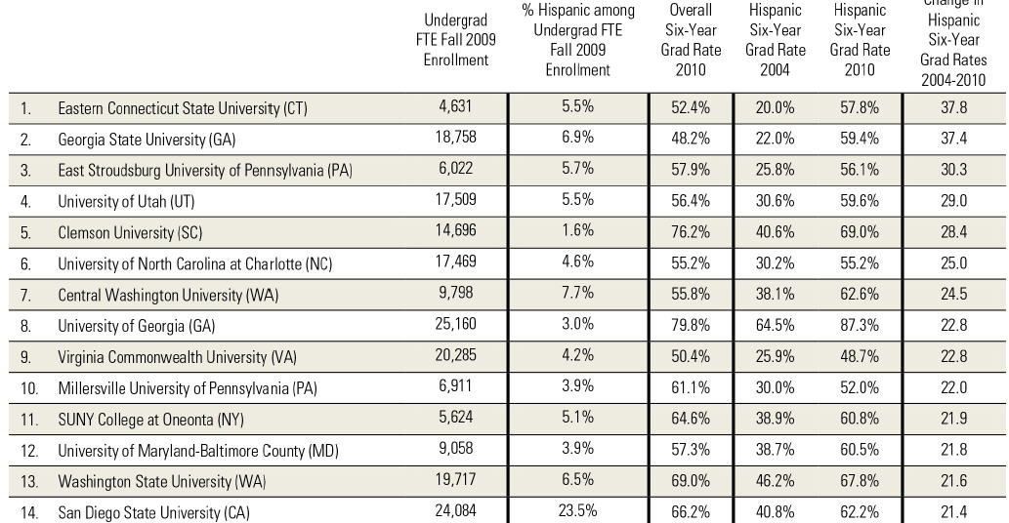
Biggest Gainers in Success for Latino Students: Public Colleges and Universities
Advancing to Completion, 2012, The Education Trust.

Slide 110
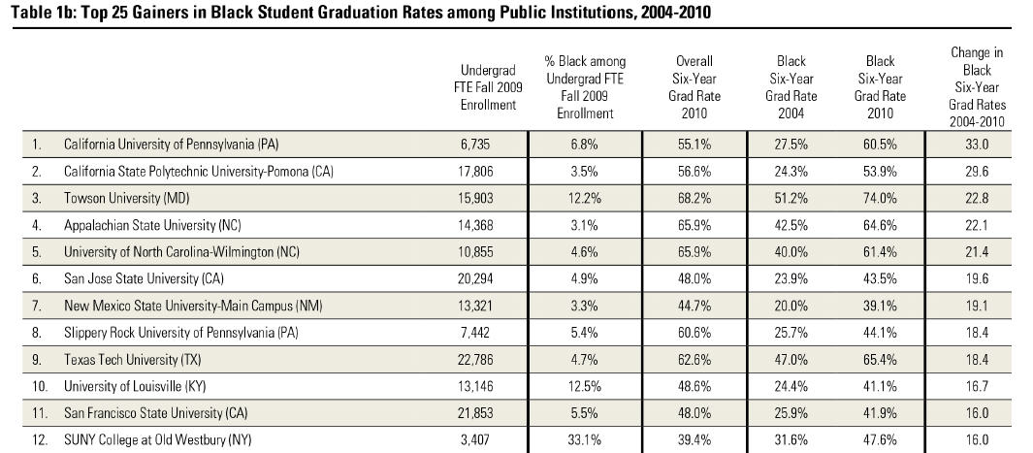
Biggest Gainers in Success for Black Students: Public Colleges and Universities
Advancing to Completion, 2012, The Education Trust.

Slide 111
Bottom Line:
What colleges do makes a very big difference.

Slide 112
What can we do?
n/a

Slide 113
First, we have to continue to improve student preparation in our middle and high schools.
Better preparation single strongest lever we have.

Slide 114
And from the leaders, we know that:
Principal leadership is hugely important;
We also need teachers who know their subjects, how to teach them…and believe that all kids are capable of doing what it takes to succeed in postsecondary education.

Slide 115
Beyond that, we know that:
More students need to complete a full, college-preparatory curriculum;
Student supports—including more instructional time—are critical; and,
Teachers need help in aligning the content of their courses, including their daily assignments to students, with college- and career-ready standards.

Slide 116
Students can do
no better than
the assignments
they are given...

Slide 117
Grade 10 Writing Assignment
A frequent theme in literature is the conflict between the individual and society. From literature you have read, select a character who struggled with society. In a well-developed essay, identify the character and explain why this character’s conflict with society is important.

Slide 118
Grade 10 Writing Assignment
Write a composition of at least 4 paragraphs on Martin Luther King’s most important contribution to this society. Illustrate your work with a neat cover page. Neatness counts.

Slide 119
Grade 7 Writing Assignment
Essay on Anne Frank
Your essay will consist of an opening paragraph which introduced the title, author and general background of the novel.
Your thesis will state specifically what Anne's overall personality is, and what general psychological and intellectual changes she exhibits over the course of the book
You might organize your essay by grouping psychological and intellectual changes OR you might choose 3 or 4 characteristics (like friendliness, patience, optimism, self doubt) and show how she changes in this area.
Source: Unnamed school district in California, 2002-03 school year.

Slide 120
Grade 7 Writing Assignment
My Best Friend:
A chore I hate:
A car I want:
My heartthrob:
Source: Unnamed school district in California, 2002-03 school year.
Notes:
This school, not far away, 97% free and reduced price lunch, 99% latino.
FILL IN THE BLANK. OTHERS: A NEAT EXPRESSION __________
Colleagues at ET: Students can do no better than the assignments given.

Slide 121
That was pre-College-and-Career-Ready Standards.
Do new standards change that?
A brand new EdTrust study

Slide 122
A Deeper Look at What We Did
Analyzed and scored close to 1,600 assignments using our Literacy Assignment Analysis Framework.
Alignment With the Common Core
Centrality of Text
Additional Features Analyzed
Text Type and Length
Writing Output
Length of Assignment
Student Thinking
Domains of Rigorous Student Assignments
Cognitive Challenge
Motivation and Engagement

Slide 123

GRADE 7– English Language Arts
How can we make our voices heard? After reading I am Malala, write a literary essay in which you answer this question. Select and analyze one of the following:
  Any key person from the text
  The setting
  A theme from the text
Support your argument with evidence from the text. In your piece, be sure to write at least 5 paragraphs and follow the structure of a literary analysis.
Notes:
Key Talking Points:
Assignment fell within the HIGH RANGE on the literacy framework (met 6-8 indicators).
This culminating writing assignment comes at the end of a four week unit during which students read and discussed the text I am Malala through the lens of making one’s voice heard.
Strengths:
The task aligns with the Common Core standards; students are expected to build and support a thesis by analyzing textual evidence. Additionally, they are prompted to acknowledge a counterclaim – a distinguishing expectation in the standards for seventh grade writers.
The directions are clear; students know what is expected from them.
The text is central is this assignment; select and analyze textual evidence to support their argument.
High cognitive push for students; they must plan and develop their essay by deciding what their thesis will be, how they will defend or justify it and how they will sequence their ideas across multiple, cohesive paragraphs.
The overarching question of how one makes their voice heard in the world today may resonate for seventh grade students. This question, coupled with a contemporary nonfiction text focused on girl of similar age faced with challenges and injustices may engage students; there is strong potential for students to see the relevancy in these topics and ideas.
Points to Consider:
Text and Task Complexity: The Lexile of the text is 830; which falls into the Grades 4-5 range. While it is a straightforward literary nonfiction text, the setting and culture described in it may be unfamiliar for many students who have grown up in the United States. Additionally, the task students are asked to do with this text is complex and aligns with grade level standards. Question to Consider: Is it appropriate to use a text with a lower Lexile score if the assignments demands cognitive challenge for students that is aligned with grade level standards?
Scaffolds: Within the assignment there are specific expectations laid out by the teacher. They are told to write at least five paragraphs and to follow the structure for a literary analysis (we can infer that this structure was taught to students prior to this assignment). Additionally, students are cued to include an introduction, reasons, analysis, and a conclusion. They are also prompted to use the text and any notes or graphic organizers they have completed over the past four weeks. Two self-checklists are also provided as part of the assignment. Question to Consider: Are the embedded scaffolds a help or a hindrance for seventh grade students?
Motivation and Engagement: There is limited choice in this assignment. Although all students are expected to base their essay on the text I am Malala, students are allowed to choose how they will frame their analysis (e.g. any key person, the setting, a theme). As mentioned above, there is potential relevancy in the question of making one’s voice heard – and the ideas in this text are indeed contemporary and are expressed through the words of a young person. Questions to Consider: Are there other ways that choice and relevancy could be incorporated into this assignment?

Slide 124
GRADE 7 - English Language Arts
Read the poem, then fill in the blanks to create your own poem to communicate your thoughts and feelings about unfinished business in your life.
The Song I couldn’t Finish
by Jeanne
The words I couldn’t say
The call I couldn’t make
The time I couldn’t spend with you
The walls I couldn’t break through
The breath I couldn’t take
The air I couldn’t release
The love I couldn’t feel
The person I couldn’t convince
The song I couldn’t finish
Notes:
Key Talking Points:
Assignment fell within the LOW RANGE on the literacy framework (met 0-2 indicators).
Students are assigned to read a simple poem and then are tasked to create their own poem which mirrors it
Scaffolding is present throughout this assignment
The “fill in the blank” cloze activity leaves little room for choice and fostering student autonomy; although students are able to make changes to the proscribed outline
While the topics and ideas of the poem may resonate for young adolescents, they represent standalone points – rather than linked to ELA content or complex texts
Strengths/Weaknesses:
Assignment is clear, but does not align with Grade 7 Common Core ELA standards for reading or writing
The text is simple; students are not required to cite evidence or justify their thinking
Poetry writing is presented in a lockstep, proscribed manner
Few opportunities for creation/choice; relevance is linked with low-level; simple materials and task
Questions to Consider:
How might students engage in poetry writing that both honors their unique perspectives and pushes for complex thinking?
How can assignments couple relevance and engagement with rigorous content, texts, and tasks?

Slide 125
GRADE 7 - English Language Arts (continued)
The words I couldn’t say
I couldn’t say ___________________________
The things I couldn’t change
I couldn’t ______________________________
The walls I couldn’t break through
I couldn’t find a way to __________________
The feelings I couldn’t feel
I couldn’t ______________________________
The help I couldn’t give
I couldn’t ______________________________
The song I couldn’t finish
The song was about ____________________

Slide 126
GRADE 8 – Social Studies
#BlackLivesMatter -OR- #AllLivesMatter?
Read and analyze “How Black Lives Matter moved from a hashtag to a real political force” and select quotes from “All Lives Matter”.
Participate in a Socratic Seminar using the Essential Questions as a guide for the discussion.
Respond to the following statement: “Personally, I (agree or disagree) with the #BlackLivesMatter awareness campaign because …”. Include at least 2-3 specific details of support stemming from the relevant readings and your experience in today’s Socratic Seminar.
Notes:
Key Talking Points:
Assignment fell within the HIGH RANGE on the literacy framework (met 6-8 indicators).
This assignment came at the end of a four week Civil Rights unit. Students were required to prepare for this assignment by reading and analyzing two texts and by viewing a video. As a follow-up, students were required to write a personal essay using evidence from the texts and the Socratic Seminar.
Strengths:
The task aligns with the Common Core standards for eighth grade speaking and listening (prepare for a discussion by reading and analyzing texts; note-taking, use notes as evidence for discussion, follow specific rules and procedures during the discussion, consider the ideas and claims of others; adjust position as needed, present knowledge and ideas succinctly and respectfully)
The directions are clear; students know what is expected from them.
Texts are central is this assignment as students are expected to read multiple texts prior to the discussion and to use these texts as evidence for their claims and points
Students used their prior reading and note-taking to inform their responses to the Essential Questions. Extended writing (personal essay) was a direct follow-up that included a thesis, supporting evidence and reasoning. Strategic thinking was required in multiple instances.
The discussion topic is relevant and timely. There is both choice and support for student autonomy in this assignment as the Essential Questions have been laid out in a skeletal way; there is room for students to shape the discussion in their own, unique way.
Points/Questions to Consider:
Discussion: Similar to the Grade 7 history example, this assignment highlights how discussion can align with the rigor of the Common Core. This thoughtful framing fostered deeper understanding of a complex issue and pushed students to think critically about it as they practiced their argumentation skills. Notice again, that this discussion assignment came after students read and took notes and before a reflective assignment which would require them to write a personal essay using evidence and reasoning. It is another strong example of the cyclical relationship between reading, writing, speaking and listening. Question to Consider: As we develop and implement multi-week units of study, when and how do we include opportunities for formal discussion?
Engagement and Motivation: Many young adolescents will connect to the Seminar’s topic given its prominence in the news and across social media outlets. Additionally, issues such as racial equity and justice, fairness, authority and power structures, may resonate for young adolescents. In some classrooms, this current event discussion might have occurred as a standalone event. However, this teacher seized the moment to place the discussion at the end of a unit of study on Civil Rights that analyzed a range of historical topics including the Jim Crow South, the Freedom Riders, the death of Emmett Till, and the different strategies employed by Civil Rights’ leaders (e.g., Booker T. Washington, W.E. DuBois, Martin Luther King, Marcus Garvey, Malcolm X). This placement bridged the known with the unknown as students made connections between the present and the past. It afforded them an opportunity to more deeply understand the historical significance of the Black Lives Matter movement. Questions to Consider: How do we design assignments that tap “big ideas” and themes -- that speak across cultures and generations? How can we use these “big ideas” and themes to pull our students into new or unfamiliar content?

Slide 127
GRADE 8 – Social Studies (continued)
Socratic Seminar Essential Questions:
“All Lives Matter”: What does the quote mean to you? Do you agree or disagree with the quote and why?
Why do you think some people have said “All Lives Matter” in response to “Black Lives Matter?” How does this impact the Black Lives Matter movement? Is one of the terms more appropriate?
What would… Booker T. Washington/WEB DuBois/Martin Luther King Jr/ Malcolm X/Marcus Garvey say about this issue?
Given all of the racially-fueled incidents that sparked the #BlackLivesMatter movement, whose strategy for achieving racial equality and harmony would be the most applicable in 2015 and why? How can we, as members of the school Community, help to raise more awareness about such a controversial, yet relevant topic such as this?
WHAT IF … these police related shootings had been carried out by members of the same race? IS “race” the only contributing factor to these police-related shootings? Justify/Explain.

Slide 128
GRADE 8 – Social Studies
Listen to “The Boy Who Cried Wolf” and have a class discussion on honesty and dishonesty with the following guiding questions:
What was the moral of the story?
What is honesty and why is it important?
How did the shepherd boy’s dishonesty hurt him? How did it endanger his sheep?
Have you ever been dishonest before? Why?
What happened when you were dishonest? Did anyone ever find out? Was anyone else hurt or affected by your dishonesty?
Notes:
Key Talking Points:
Assignment fell within the LOW RANGE on the literacy framework (met 0-2 indicators).
The assignment reflects low rigor for eighth grade as students are asked to listen to the well-known Aesop fable The Boy Who Cried Wolf and then use this text as they engage in a discussion about honesty
If the overarching goal of the assignment is to discuss the complexities of honesty, might there be a more grade-appropriate text to use that aligns with the Common Core?
Strengths/Weaknesses:
Assignment is clear
Text is simplistic; students are asked to listen to the text (not read it)
Short assignment; can be completed within a single class period
Holds student thinking to a recall of basic facts or basic application of ideas (e.g., What was the moral of the story? What is honesty and why is it important?)
Not connected to any writing
The topic of honesty may resonate with young adolescents; the discussion prompts may feel relevant as students are asked to consider their own experiences with honesty/dishonesty
Questions to Consider:
How do teachers select texts for students? Are simplistic texts ever appropriate for eighth grade students? If so, when and how?
How can we engage students in more authentic ways in order to bridge their learning from known to unknown? How do we link with relevance with rigor?

Slide 129
In isolation, the low assignments can reflect targeted skill building and student practice…not necessarily harmful in moderation

Slide 130
However when compounded over multiple class periods, in multiple subjects, over multiple years, the effect is detrimental.

Slide 131
Ed Trust Assignment Study:
What We Found
Fewer than 4 in 10 middle grades assignments are targeted at a grade-appropriate standard;
In high poverty schools the proportion drops to only about one third, compared to nearly half of assignments in low poverty schools;
That said, only about 5% of assignments in both kinds of schools tapped into the higher-level cognitive demands of the CCSS;
Most efforts at engagement and relevance were superficial, and often condescending.
Notes:
Text from current PPT presentation

Slide 132
These things need attention.
K-16 Structures Should Make Improving Preparation a Top Priority

Slide 133
Second, we also have to keep pushing for better state and federal policy.
Key targets include expanding need-based aid and reversing state disinvestment.

Slide 134
In the meantime, though, there is a lot that colleges can do.
What do we know from the fastest gainers?

Slide 135
1. Their leaders make sure student success is a campus-wide priority.
n/a

Slide 136
Improving student success isn’t all—or even mostly—about programs.
It’s about institutional culture that values success and that accepts responsibility.
n/a

Slide 137
Successful leaders honor and tap into institutional culture to privilege student success

Slide 138
In fact, successful leaders consistently treat faculty as problem solvers, not as problems to be solved.

Slide 139
2. They look at their data…and act.
Use of disaggregated data to spot problems and frame action is pervasive.
n/a

Slide 140
Successful institutions don’t just aim at the final goal—graduation—they concentrate on each step along the way, especially the early ones.
n/a

Slide 141
Keeping your eyes on both retention and credit accumulation

Slide 142
First-Year Retention vs. Credit Accumulation
The Silent Retention Problem
Georgia State University.
Notes:
Need to work this Georgia State example into Kati’s themes. More precise source?

Slide 143
3. Where can the data take you? Successful institutions create clear, structured pathways to success.
n/a

Slide 144
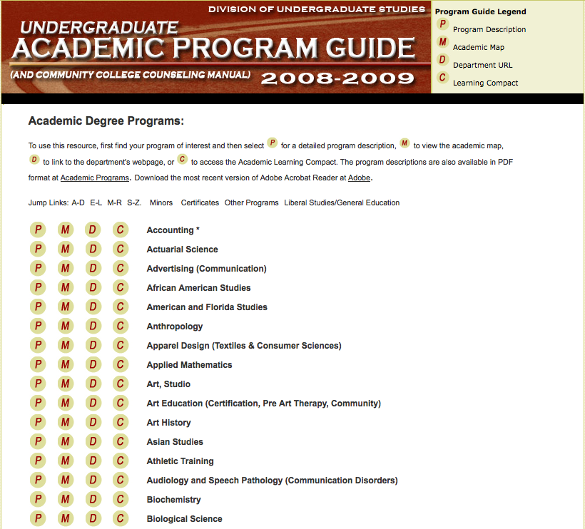
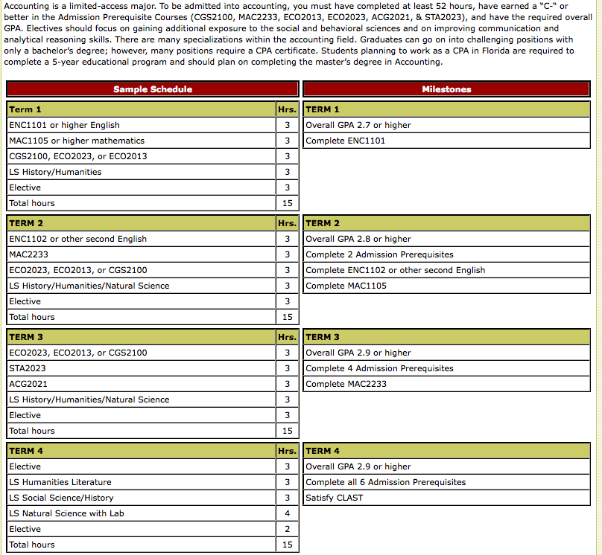
FLORIDA STATE ACADEMIC MAP
144

Slide 145
4. They take on Introductory and Developmental Classes
n/a

Slide 146
5. Where else can the data take you? Successful institutions don’t hesitate to demand, require.
n/a

Slide 147
A lot of institutions know what works. And more and more of them are advising students to do those things.
But it turns out that “students don’t do optional.”

Slide 148
6. They bring back the ones they lose.

Slide 149
It’s really not about boldness of reform.
It’s about intentionality and quality of execution.
© 2014 The Education Trust

Slide 150
In other words, what institutions do to help their students succeed matters.
A lot.

Slide 151
Download this presentation on our website
www.edtrust.org
Washington, D.C. Metro Detroit, MI
202/293-1217 734/619-8009
Oakland, CA
510/465-6444

